Slide 1
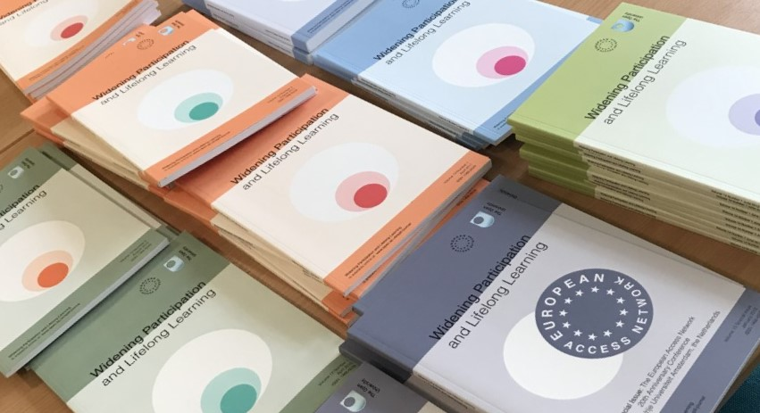

Slide 2
Widening Participation and Lifelong Learning Special Edition – December 2021
Editors
Dr Jenny Douglas, The Open University, UK
Email: jenny.douglas@open.ac.uk
Prof John Butcher, The Open University, UK
Email: john.butcher@open.ac.uk
DOI: https://doi.org/10.5456/WPLL.23.3.1

Slide 3
Articles presented at today’s seminar
Discussion Piece article:-
University of Kent: 'Why We Need to Reimagine the Curricula in Higher Education to Make It More Culturally Sensitive'
Dave Thomas & Kathleen Quinlan
Innovative Practice article:-
University of Law: ‘Co-Creating with BAME Students in Legal Education’
Dr Morag Duffin, Fatmata K. Daramy and BAME Advocates - Teagan Williams, Ibrahim Ilyas & Priscilla Wegbe
Full Research article:-
University of Brighton: ‘Identifying and Addressing Differential Black, Asian and Minority Ethnic Student Experiences at a Post-1992 Institution
Joanna MacDonnell and Dr Jo Hall

Slide 4
Innovative Practice articles Edge Hill University: #Ibelong: Towards a Sense of Belonging in an Inclusive Learning Environment Liz Thomas University of Cambridge: Target Oxbridge Year 10 Programme Jon Datta and Naomi Kellman Edge Hill University: Collaboration and Co-Production with Black, Asian and Minority Ethnic Students: Working in Partnership with Our Students to Inform and Deliver Access and Participation Practice Heather Lloyd and Reena Kaur

Slide 5
Innovative Practice articles University of Law: Exploring and Developing Strategies for Integration in a Classroom Setting, Within Higher Education Shaid Parveen The Open University: The Voice of Students from a Black, Asian or Minority Ethnic Background Joan Simons and Patrice Belton

Slide 6
Discussion Piece articles
University of Hertfordshire: Exploring the ‘Unexplained’ Awarding Gap Through Understanding BAME Students’ Experiences
Sara de Sousa, Judy St. John and Emmanuella Emovon
University of Hertfordshire: Inclusive Curriculum and BAME Student Advocacy: Reflections on Three Years of Inclusive Module Reviews
Sara de Sousa, Tejal Mistry and Omotolani Fatilewa
Research Note article
The Open University: How Do We Talk About Race…and Mental Health?
John Butcher, Rehana Awan and Darren Gray

