Slide 1
OU-APS Seminar: Lessons from Digital Spaces: Inclusion and Support for Student Success
25th May 2022
Pivoting Transitions to the Online Space: An example of student engagement in action
Dr Karen Campbell & Ms Farah McAdam

Slide 2
Transition Programme
College students
20% most socially deprived areas
Entering year 2 or 3 of 4-year Scottish Hons degree
Nine weeks, discipline specific, 'taster' lectures + workshops on academic skills
College Connect Team
Mentoring
Pre-Covid-19:
Face-to face
On campus

Slide 3
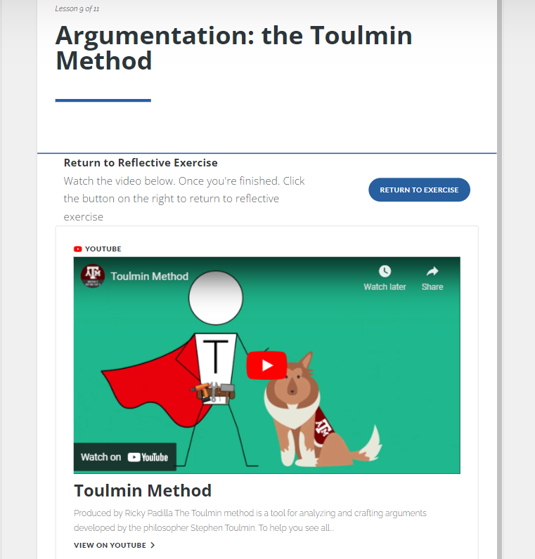
Delivering the Transition Programme – Student Engagement
Asynchronous online course with synchronous webinars and lectures
Articulate 360 suite used to build programme
Webinars and lectures hosted on Blackboard Collaborate Ultra
Engagement with College Connect Team and Student Mentors
Feedback collection via module surveys

Slide 4
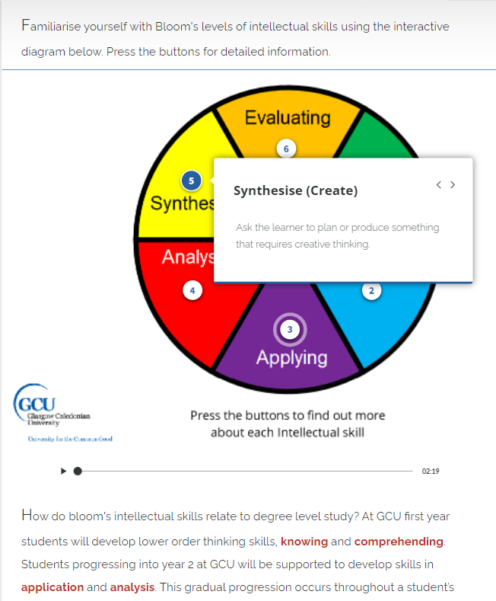
Delivering the Transition Programme - Challenges
Short time for redevelopment
Establishing connection with students
Building a sense of community

Slide 5
Outcomes and Student Feedback
Increased attendance - 12% increase in attendance (1015 v. 907 in 2019)
Increase in number of students articulating to degrees with advanced standing (853 articulating to Year 2 or Year 3 entry), 163 entering Year 1
16% increase from 2019 (734 articulating students)
Increase in percentage articulating from SIMD 40: 57% of students from lowest 40% SIMD quintile (up from 50% in 2019)
94% students found programme ‘extremely beneficial’ or ‘quite beneficial’

Slide 6
Impact – Engagement
Zepke and Leach’s Ten Proposals for Action:
Enhancing students’ self-belief
Enable students to work autonomously, enjoy learning relationships with others and feel they are competent to achieve their own objectives
Recognise that teaching and teachers are central to learning
Create learning that is active, collaborative and fosters learning relationships
Create learning opportunities for students that are challenging, enriching and extend their academic abilities
Ensure institutional cultures are welcoming to students from diverse backgrounds
Invest in a variety of support services
Adapt to changing student expectations
Enable students to become active citizens
Enable Students to Develop their Social and Cultural Capital

Slide 7
Examples
Welcoming institutional culture
Collaborative learning relationships
Self-belief
Recognise that teaching and teachers are central to learning
Signposting support
Becoming active citizens

Slide 8
Moving forward
Further research:
Other protected characteristics and inter-sectionality
Progression, retention and success
Sense of belonging and delivery mode

Slide 9
Thank You
Dr Karen Campbell
Research Fellow, Educational Research and Evaluation
Karen.Campbell@gcu.ac.uk
https://www.gcu.ac.uk/adsl/meettheadslteam/karencampbell/
Ms Farah McAdam
GCU College Connect Development Officer
Farah.mcadam@gcu.ac.uk
https://uk.linkedin.com/in/farah-mcadam-5a677019a
https://www.gcu.ac.uk/study/collegeconnect/meettheteam/

