Slide 1
INTERSECTIONALITY: HOW THE MULTIPLIER EFFECT DIVIDES AND REDUCES STUDENTS’ SUCCESS

Slide 2
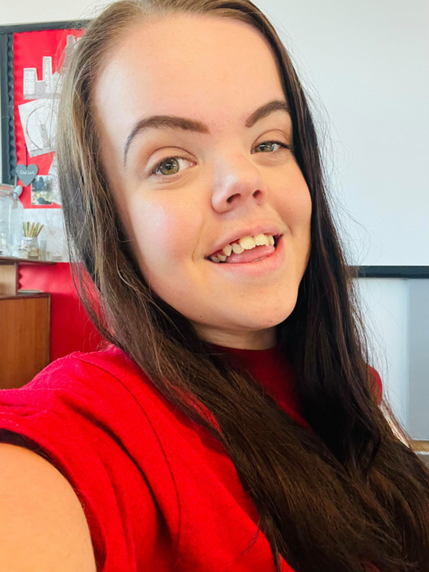
LET ME INTRODUCE MYSELF…
DANIELLE WEBB
Born with Achondroplasia (Short limb Dwarfism).
22 years old- 3ft 11. Typical height and of the average 7-year-old.
Started at USW in 2017 on my BA (Hons) degree in Youth and Community Work - now studying my MA degree in Working for Children and Young People.
First in Family to attend University

Slide 3
INTERSECTIONALITY AND ME.

Slide 4
SCHOOL AND COLLEGE
School was never my scene
The only student in my school with a physical disability
Came away from year 11 with 7 GCSEs
Studied my Level 3 BTEC Diploma in Children’s Play, Learning and Development
Left college with an MMP diploma
Didn’t apply for University until last minute

Slide 5
THE BARRIERS OF TRANSITIONING TO HE
First in Family to attend university, no expectations
Single parent and low-income household. Student finance worries
Physical hurdles to consider
First time getting on a train was to attend an open day
First person to attend USW with dwarfism
No representation to aspire to

Slide 6
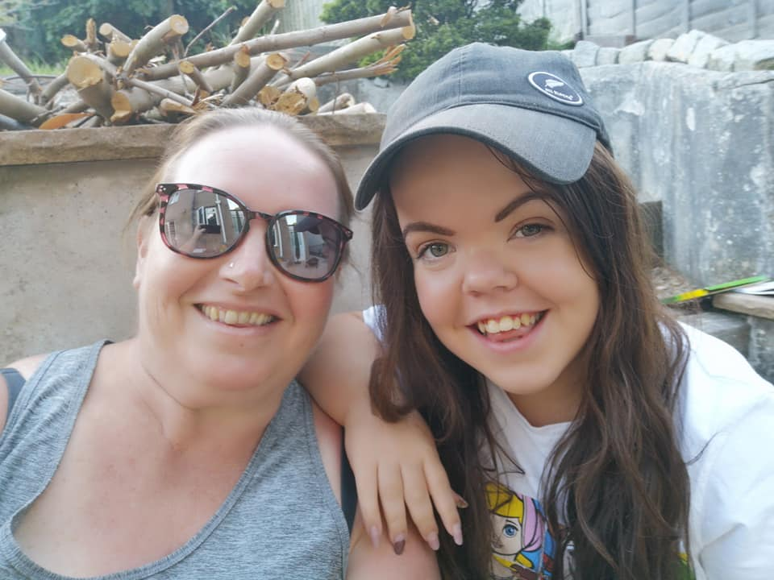
LIFE AT HOME BEFORE UNI
Single parent family
Only person in my family with Dwarfism
Low-income household
First in family to go to university.
Do only rich people go to university?
Who would be able to support my
disability needs?
Would my application be jeopardised
as a result of my background?

Slide 7
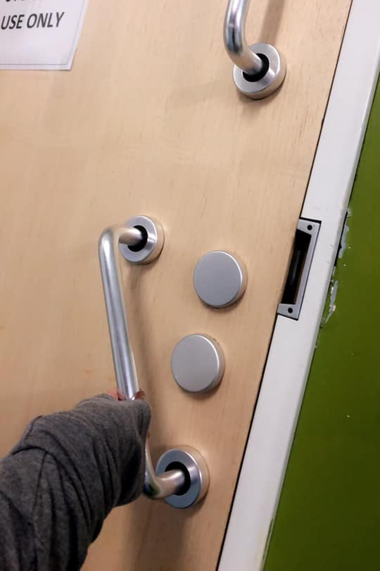
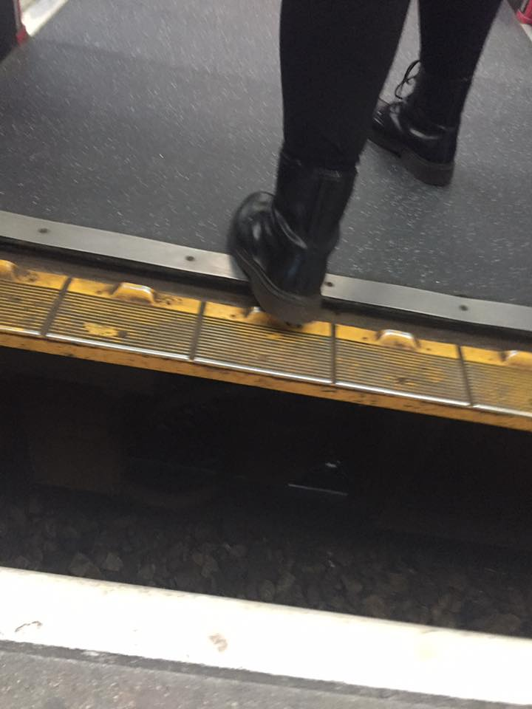
STEPS TO UNIVERSITY
Practice train journeys.
Open days.
Induction Week.
Evaluation tour of campus to identify physical hurdles- quick fixes put in place where possible.
Disability advice and support.
Staff arranged transport to the train station until I was comfortable enough to make my own way to campus.

Slide 8
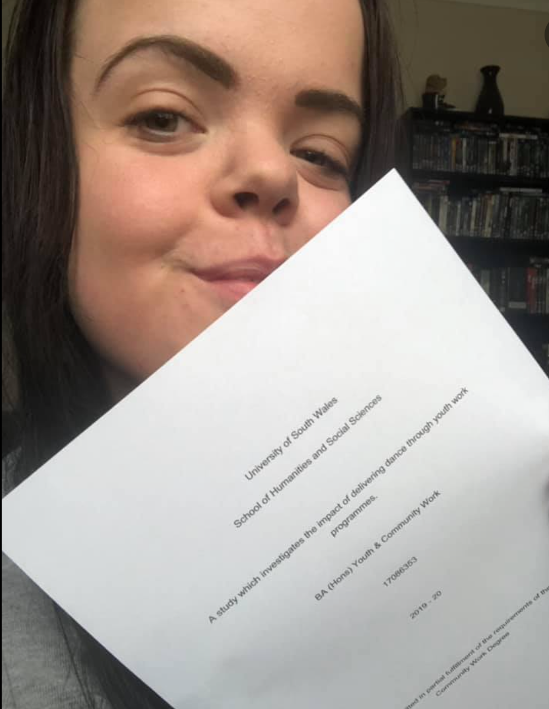
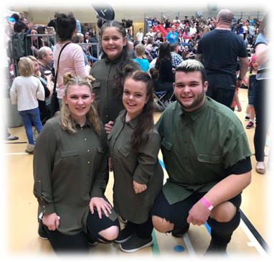
MY USW EXPERIENCE IN A NUTSHELL
Four academic years
Two degrees: BA (Hons) Youth and Community Work, MA Working for Children and Young People
Four work placement settings
Produced a community stage show as my final module project

Slide 9
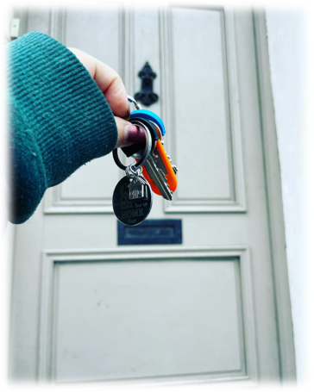
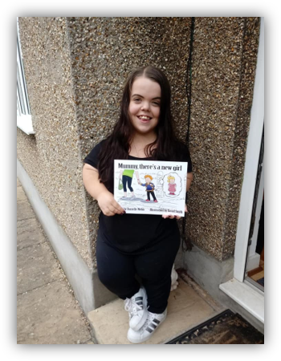
MY PERSONAL MILESTONES
Exchange programme to Belgium in level 4; my first solo trip away from home
Moved to Newport in my final year of studies
Two USW based employments; Student Ambassador in second year- Graduate Intern Student Recruitment Officer
June 2021, I published my first children’s book promoting positive understanding of diversity

Slide 10
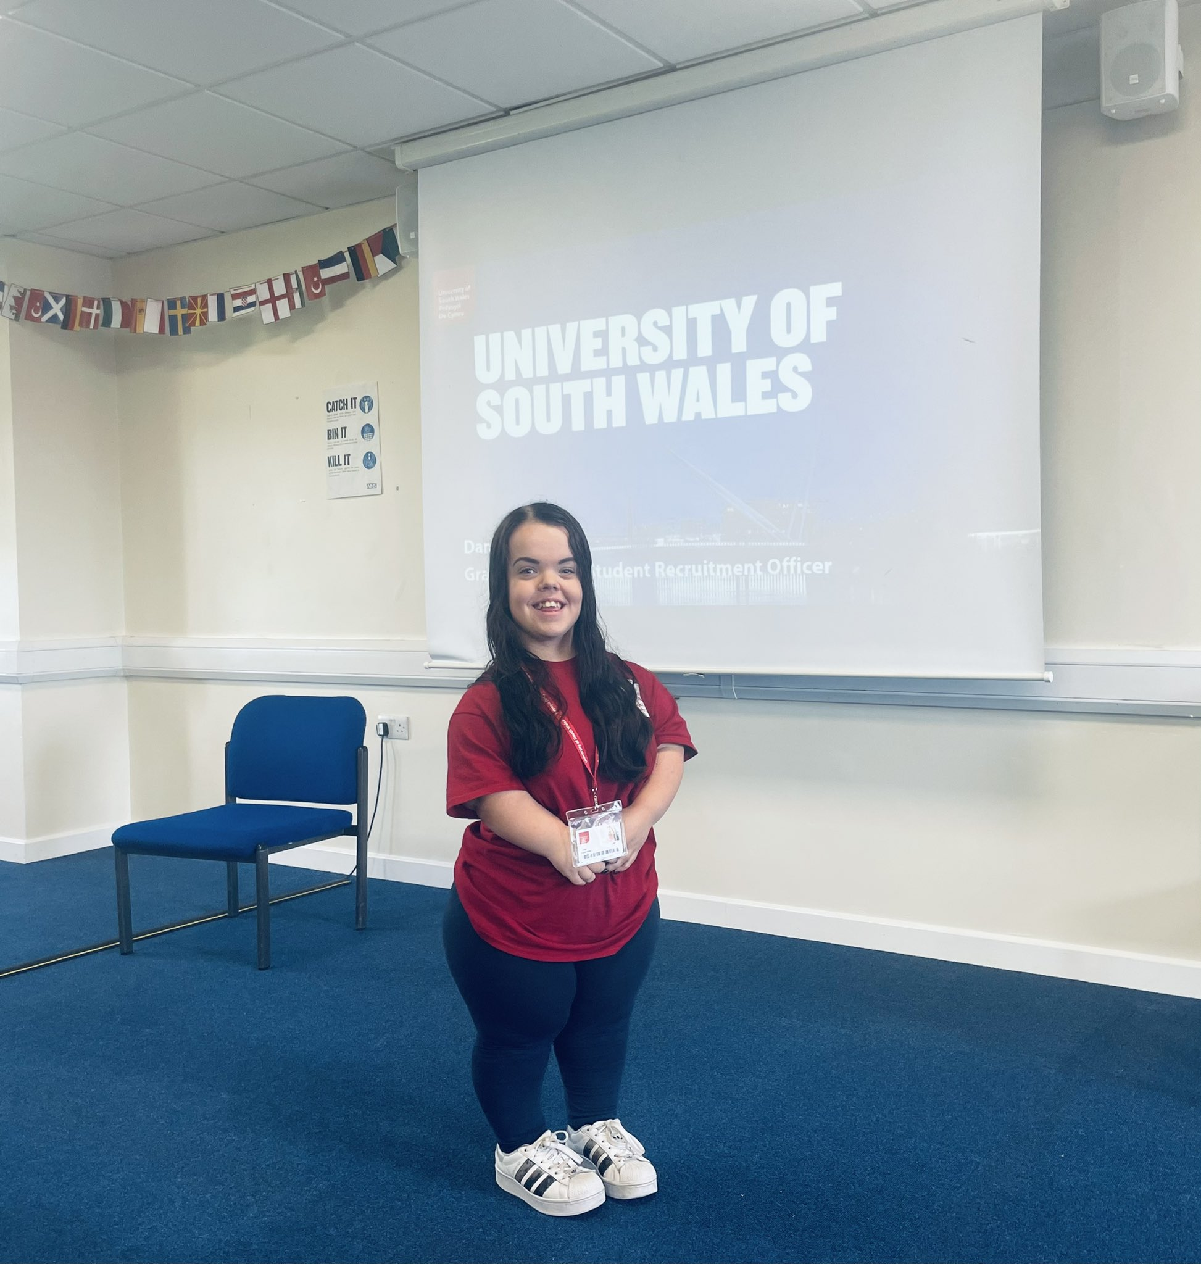
LOOKING AHEAD
Finishing my MA degree in Spring 2022
Working with the Disability and Wellbeing Team and Estates at USW to promote accessibility and inclusion
Continuing working within the MSR team at the University
Living independently in my first home in Newport
Beginning the process of getting my children’s book translated into Welsh

Slide 11
THANK YOU FOR LISTENING.

