Slide 1
Intersectionality in STEM What can we learn from the data surrounding Ethnicity, Gender and Index of Multiple Deprivation (IMD)?
Andrew Potter, Deputy Associate Dean (Academic Excellence), STEM
Diane Butler, Associate Dean (Academic Excellence), STEM
Afua Acheampong, Equality, Diversity and Inclusion (EDI) Manager, STEM
Jonathan Evans, eSTEeM Project Officer, STEM

Slide 2
Intersectionality in STEM
Introduction
We present some data which looks at intersectionality between:
Gender and Ethnicity
Ethnicity and Index of Multiple Deprivation (IMD).
We will look at data:
On a module level
SDK100 Science and health: an evidence-based approach
SK299 Human biology
On a Board of Studies level
The School of Mathematics and Statistics
We will consider:
How useful the data is in understanding intersectionality
What approaches we can take to investigate and address intersectional issues

Slide 3
Intersectionality in STEM
Caveats
We will look at the pass rate for students. (APS also looks at good pass rate, but this is not considered here.)
The graphs show the pass rate for students, split by protected characteristic. Each chart shows the pass rate for two single characteristics and the intersection of the two characteristics.
This allows us to judge whether the combined characteristics confers a disadvantage or advantage greater than that for either of the individual characteristics.
The numbers are provided to give a sense of scale. Some of the numbers are very small – so some data are omitted.

Slide 4
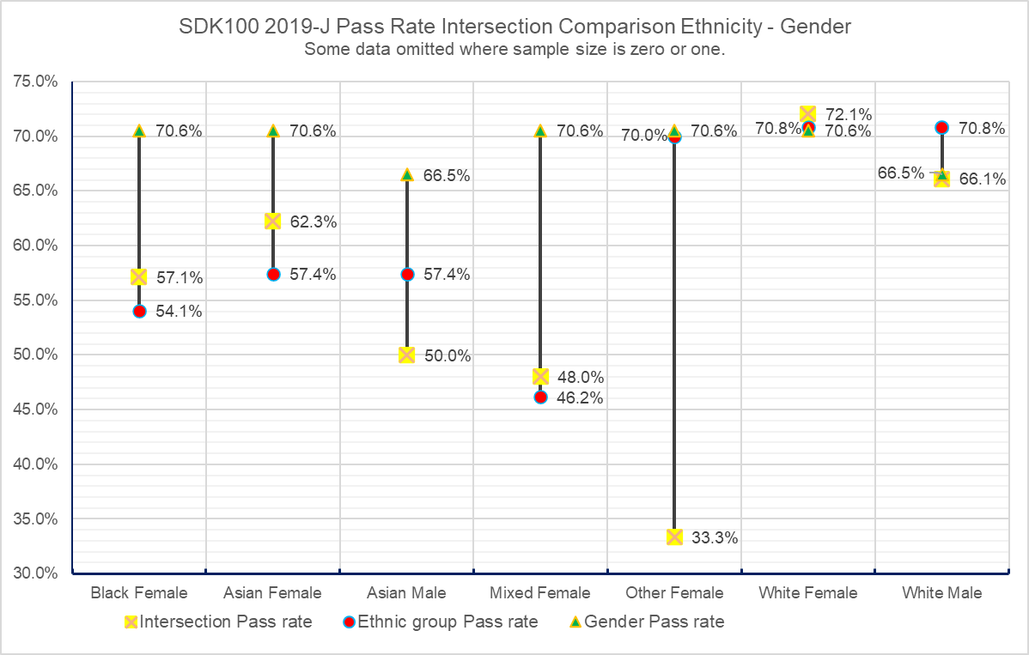
Module SDK100: Gender and Ethnicity
Student numbers in each intersection grouping
 | Black |  | Asian |  | Mixed |  | Other |  | White
 | Female | Male | Female | Male | Female | Male | Female | Male | Female | Male
Reg25Pcnt | 35 | 2 | 53 | 6 | 25 | 2 | 3 | 2 | 838 | 186
Pass | 20 | 0 | 33 | 3 | 12 | 1 | 1 | 1 | 604 | 123

Slide 5
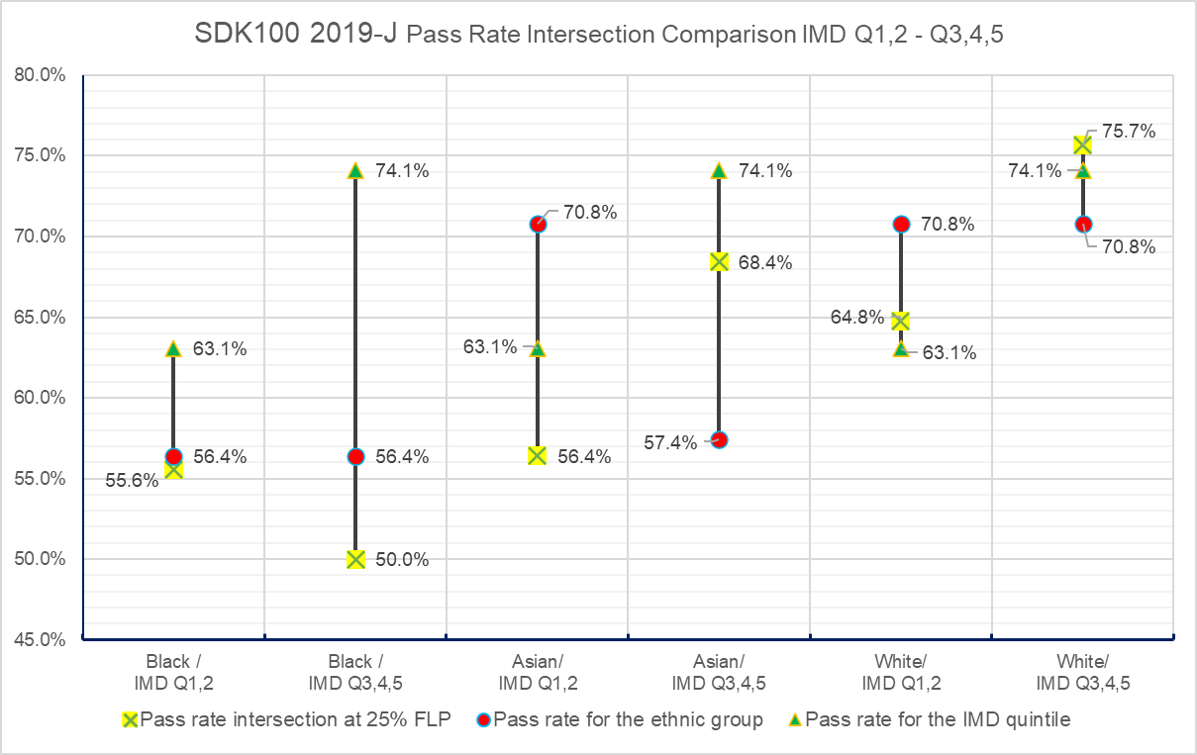
Module SDK100: Ethnicity and IMD
Student numbers in each intersection grouping
 | Black |  | Asian |  | Mixed |  | Other |  | White
 | 1+2 | 3+4+5 | 1+2 | 3+4+5 | 1+2 | 3+4+5 | 1+2 | 3+4+5 | 1+2 | 3+4+5
Reg25pcnt | 27 | 10 | 39 | 19 | 11 | 16 | 3 | 2 | 443 | 571
Pass | 15 | 5 | 22 | 13 | 6 | 6 | 0 | 2 | 287 | 432

Slide 6
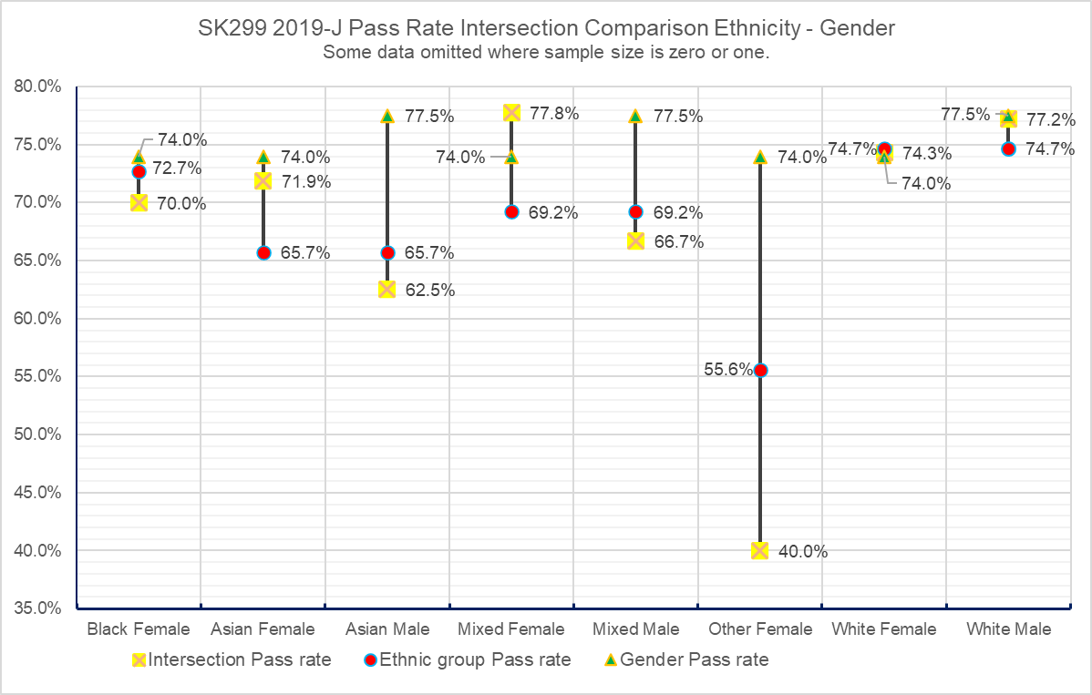
Module SK299: Gender and Ethnicity
Student numbers in each intersection grouping
 | Black |  | Asian |  | Mixed |  | Other |  | White
 | Female | Male | Female | Male | Female | Male | Female | Male | Female | Male
Reg25Pcnt | 20 | 3 | 32 | 8 | 9 | 6 | 5 | 2 | 607 | 145
Pass | 14 | 3 | 23 | 5 | 7 | 4 | 2 | 1 | 451 | 112

Slide 7
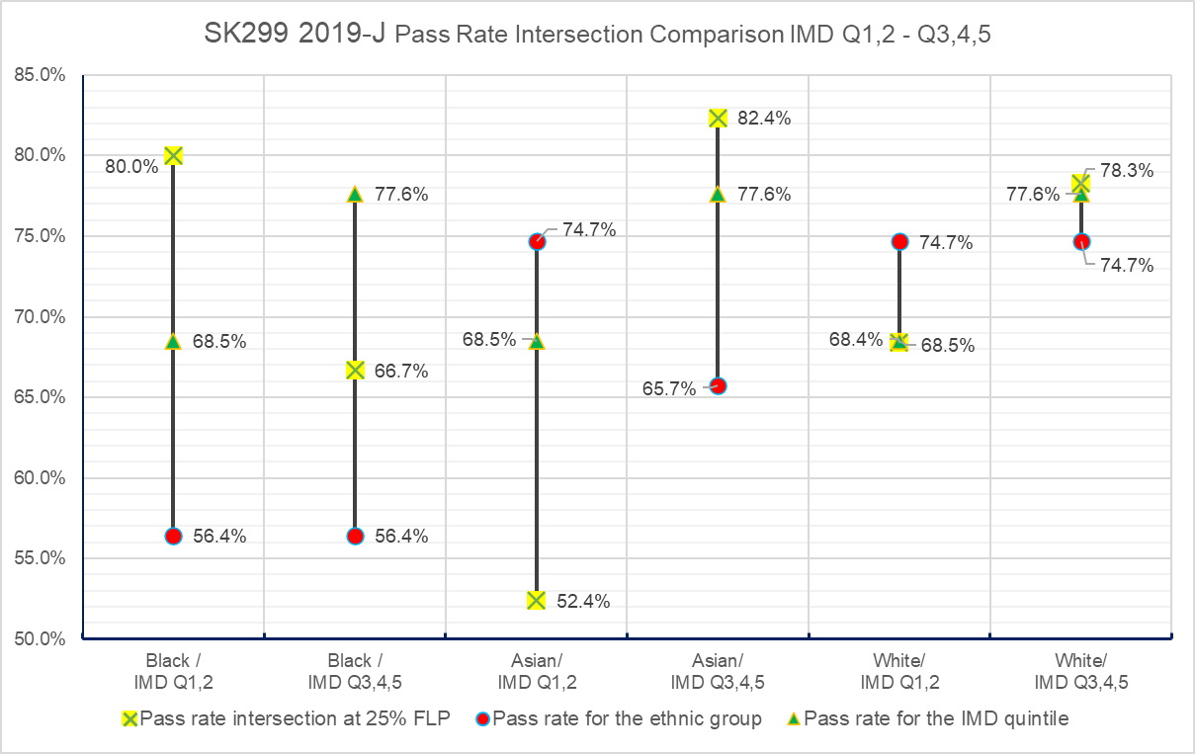
Module SK299: Ethnicity and IMD
Student numbers in each intersection grouping
 | Black |  | Asian |  | Mixed |  | Other |  | White
 | 1+2 | 3+4+5 | 1+2 | 3+4+5 | 1+2 | 3+4+5 | 1+2 | 3+4+5 | 1+2 | 3+4+5
Reg25pcnt | 15 | 6 | 21 | 17 | 8 | 5 | 3 | 4 | 272 | 469
Pass | 12 | 4 | 11 | 14 | 7 | 2 | 2 | 1 | 186 | 367

Slide 8
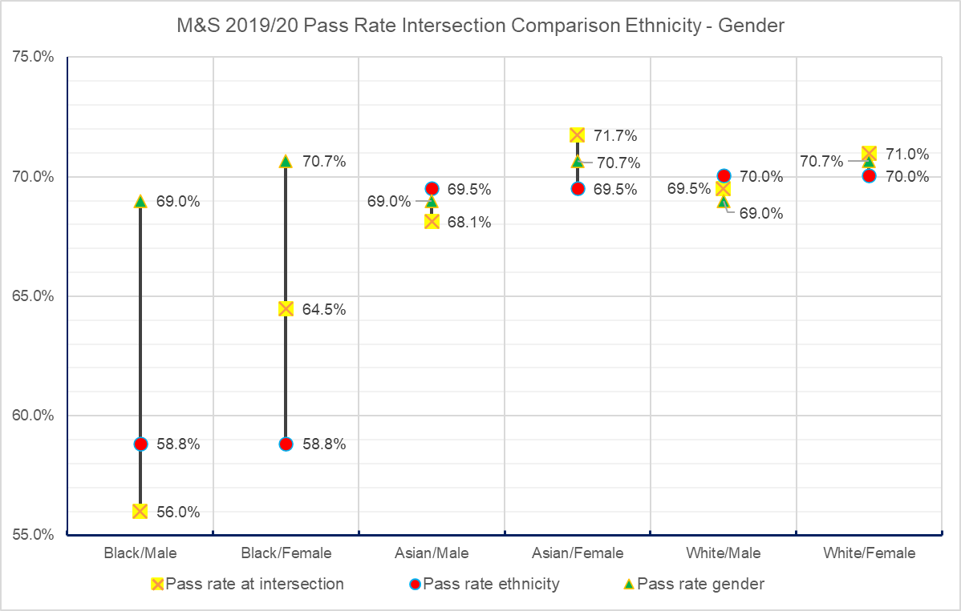
Mathematics and Statistics Board of Studies: Gender and Ethnicity
Intersection of Ethnicity and Gender for the School of Mathematics and Statistics
 | Black |  | Asian |  | Mixed |  | Other |  | Unknown |  | White
 | Male | Female | Male | Female | Male | Female | Male | Female | Male | Female | Male | Female
Reg25% | 300 | 152 | 524 | 322 | 208 | 109 | 91 | 53 | 268 | 111 | 7004 | 4030
Pass | 168 | 98 | 357 | 231 | 134 | 75 | 73 | 31 | 191 | 81 | 4869 | 2860

Slide 9
Intersectionality in STEM
Conclusions and Next Steps
Conclusions
Hiding behind these data are highly complex problems that cannot be solved by analysis alone.
Intersectional analysis helps research teams to focus efforts.
What questions should be asked?
Whom should we ask?
Scholarship of Teaching and Learning
Understanding awarding gaps for disabled and black LHCS students at Level 1, Carol Midgley and Jane Loughlin
Understanding how our assessment contributes to retention and awarding gaps for black students on LHCS modules, Jane Loughlin, Duncan Banks and Eleanor Crabb
Other initiatives
STEM Inclusive Curriculum Project
Decolonising the Curriculum Through the History of Mathematics

Slide 10
THANK YOU Andrew.Potter@open.ac.uk Diane.Butler@open.ac.uk

