Slide 1
How to display schools and/or Faculties in your slides
Value, visibility and belonging:
Exploring the impact of staff / student reverse mentoring within higher education
Rachael O'Connor – Associate Professor (Law)
Steve Gleadall – Educational Engagement Manager
University of Leeds, UK

Slide 2
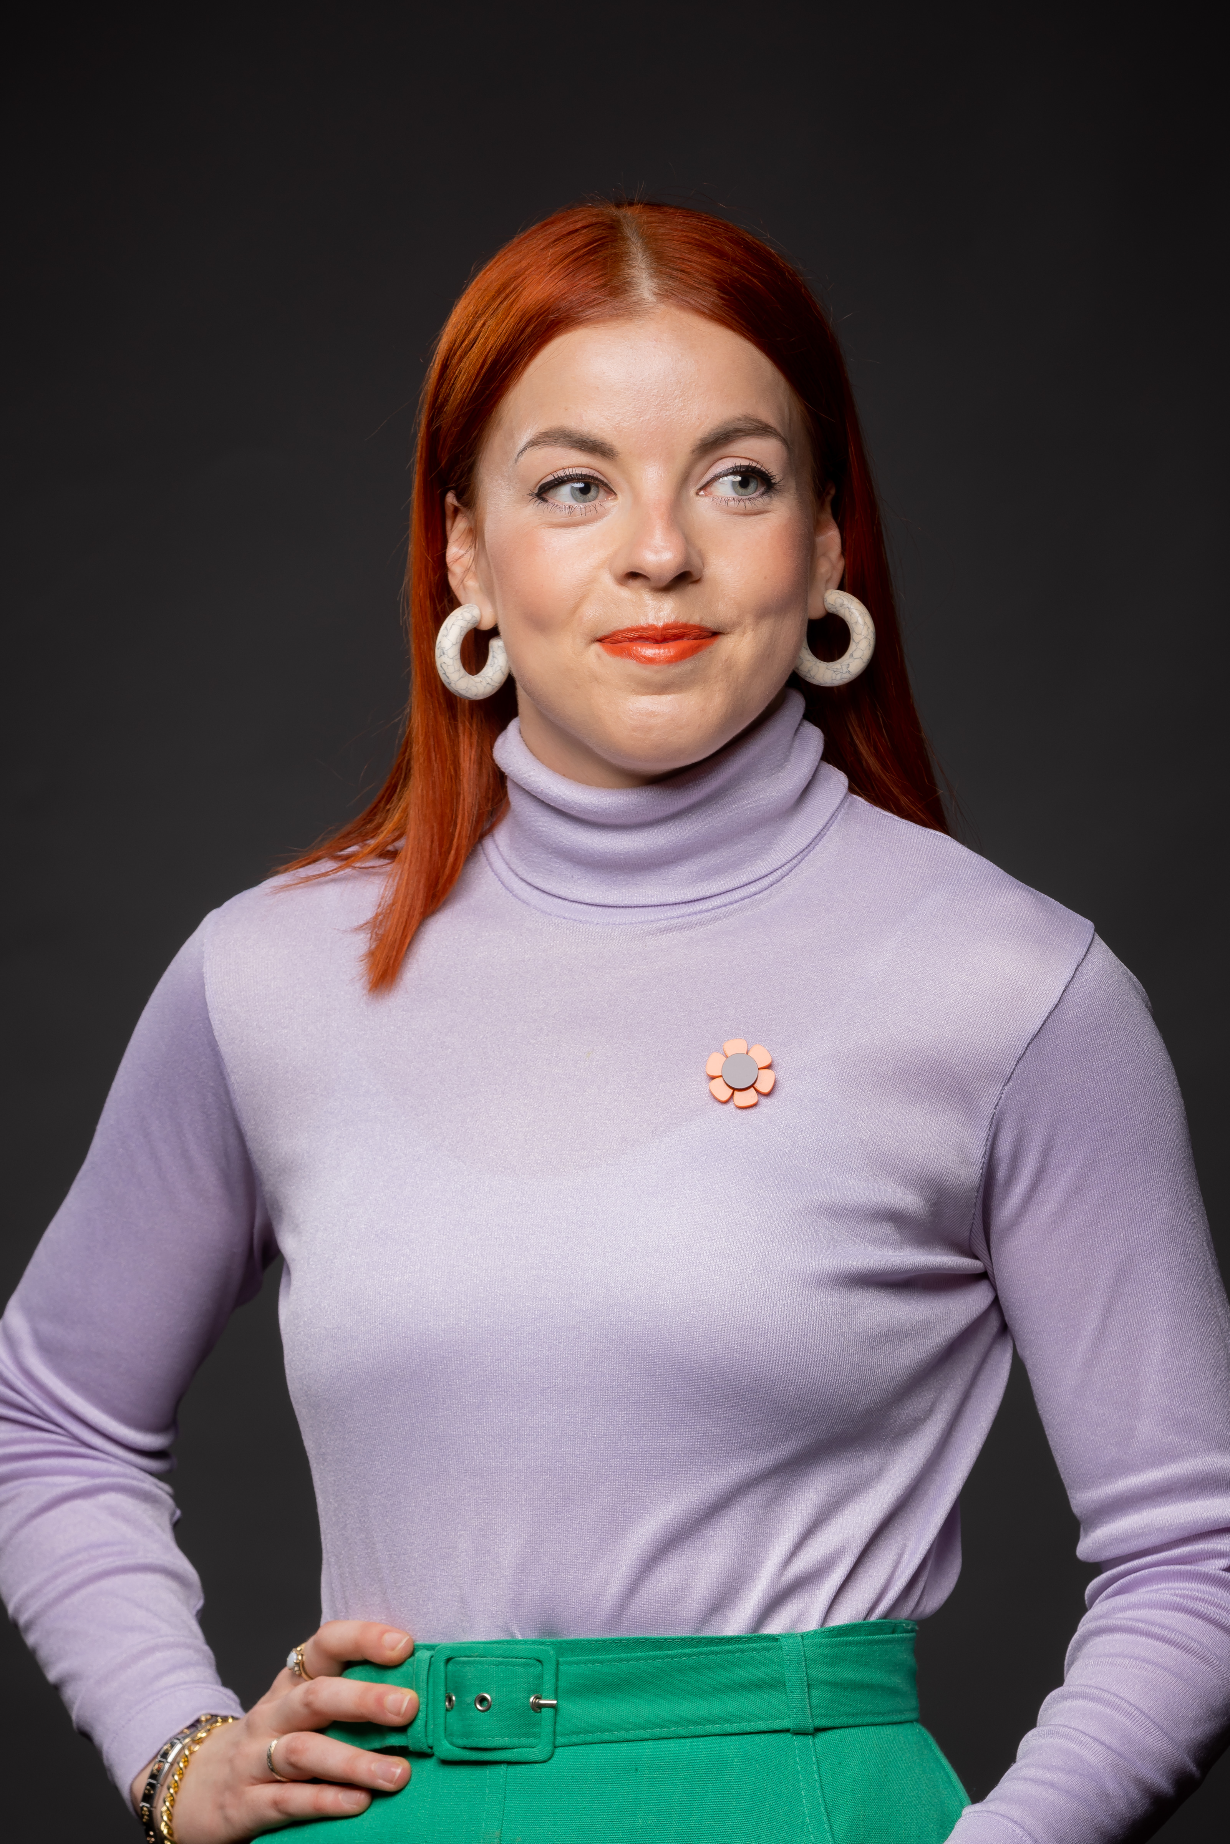
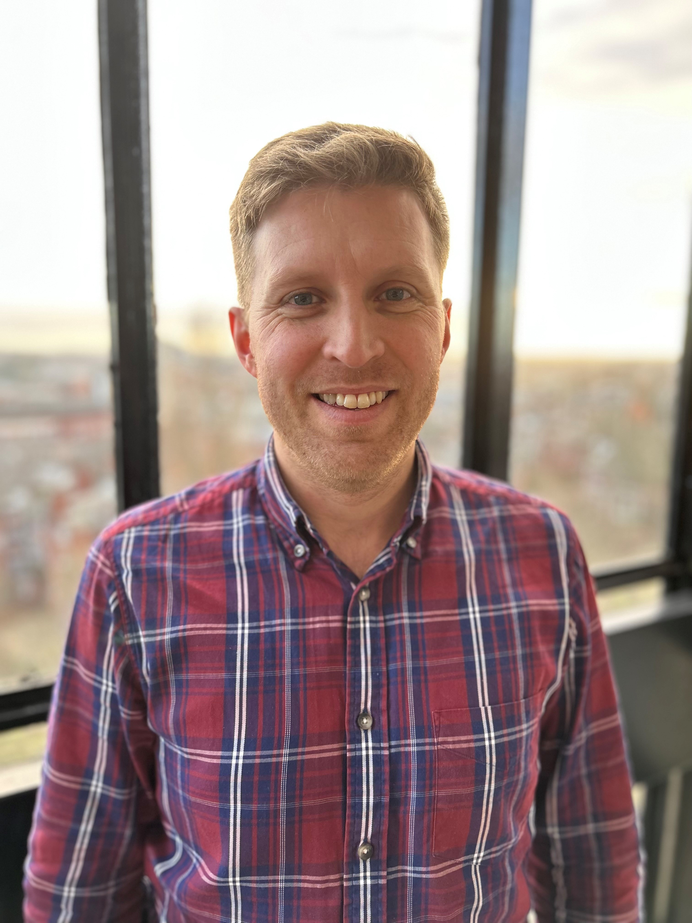
Introduction
Who are we?
What is reverse mentoring?
“… a reciprocal and temporally stable relationship between a less experienced mentor providing specific expert knowledge and a more experienced mentee who wants to gain this knowledge … characterised by mutual trust and courtesy, it aims at facilitating learning and development of both the mentor and the mentee” Zauchner-Studnicka, A Model for Reverse Mentoring in Education, International Journal of Educational and Pedagogical Sciences, 11(3), 2017

Slide 3
Where we began
Access and Student Success Strategy
"The University of Leeds will be a place where students from diverse backgrounds feel they belong, can thrive, and are valued for their unique contribution"
Rachael's pilot project
Delivered in the School of Law – international students mentoring academic and support staff - ‘‘It makes me feel empowered and that we can make a difference’: Reverse mentoring between international students and staff in legal education’ (2022) European Journal of Legal Education 3(1), 95-126
Institutional pilot project
Members of the University Executive Group participated in a pilot in 2021 to test reverse mentoring as an intervention, delivered in partnership with Leeds University Union.

Slide 4
Reverse Mentoring 2022 - Development
Positive pilot feedback and anecdotal evidence supported continuation of reverse mentoring
Renewed focus on developing a reverse mentoring programme to be embedded as part of our student success and belonging work at Leeds
Need to evaluate impact on individuals and the institution
Research approach to inform similar work at Leeds and the wider higher education sector
Collaboration between Professional Services and Academic staff

Slide 5
Reverse Mentoring 2022 - Delivery
26 Mentors - students who self-identified as being from a background underrepresented in the student community at Leeds
UK ethnically minoritised, Mature (21+) entry, International, and/or widening participation background
26 Mentees - staff holding a senior leadership position at the University
Staff, including Deans, Pro-Deans and Directors of Professional Services, were invited to participate
25 pairs successfully completed the mentoring programme
Notes:
encouragement was provided by mentees from the 2021 pilot project.

Slide 6
Our research questions
How does reverse mentoring impact:
students’ feelings of value, visibility and belonging;
staff understanding and appreciation of challenges faced by under-represented students; and
the daily practice and influence of institutional leaders within their areas of responsibility?

Slide 7
Initial findings – Impact on students
Students' feelings of value, visibility and belonging
Student mentors showed increased feelings of belonging (average score increased from 3.08 to 3.7) and value (average score increased from 3.13 to 3.45) to the University of Leeds after taking part in reverse mentoring (Scale of 1 to 5)
Mentor 1: “I think I actually felt more part of the university after this experience.”
Mentor 3: “it definitely gave me more confidence in the University to actually have … people's best interests at heart … I think generally it's giving me more confidence in the teachers”

Slide 8
Initial findings – Impact on staff
Staff understanding and appreciation of challenges faced by under-represented students
Staff mentees felt they had a better understanding of challenges faced by students from underrepresented groups (average score increased from 2.81 to 3.17) and why these students may find it challenging to engage (average score increased from 3.06 to 4.17) and feel less confident (average score increased from 3.75 to 4.50) (Scale of 1 to 5)
Mentee B: “…this really made me think differently about what inclusion means in the classroom… and how complex inclusion really is”
Mentee C: “this [mentoring] was different. It is to understand … wider perspective[s] which will … enlighten my thinking and help in formalising my ideas and actions … one of the meetings was completely devoted to equality and inclusion because [my mentor] is from [the] LGBTQ community. While I'm not, it was very interesting to learn their perspectives … [have] a friendly chat and basically learning about different cultures, different way of thinking…”

Slide 9
Initial findings – Longer-term impact
The daily practice and influence of institutional leaders within their areas of responsibility
Mentor 4: “The overall thing for me was the fact that there's somebody there in the authority, they didn't just listen, you know, they actually took on board what we said. They followed it up.”
Mentee A: “... one thing that we might do a bit better would be to think about ... opportunities that we put out for kind of networking, community building … That might be really difficult for people to do, so actually being more intentional about how we do those things ... might be a good thing … I'm going to think in my own role about how we do that kind of thing … differently.”
Notes:
In the few weeks following the project, mentors and mentees were already thinking about the wider impact of their conversations

Slide 10
Recommendations and next steps
Reverse mentoring embedded as an annual institutional activity, with executive endorsement and support
A team is identified to deliver and continuously improve reverse mentoring work, to include Professional Services and Academic staff as well as students to support delivery and continued development
Appropriate time and resource allocated to ensure continued evaluation of reverse mentoring and dissemination of outcomes within and beyond the institution
Annual reporting to capture actions identified and taken as a result of reverse mentoring conversations – wider impact over time

Slide 11
Questions
Thank you for listening – please get in touch if you'd like to hear more …
Rachael O'Connor - R.E.OConnor@leeds.ac.uk
Steve Gleadall – S.G.Gleadall@adm.leeds.ac.uk

