Slide 1
Exploring the experiences of students of minoritised ethnicities through a longitudinal community of enquiry
Prof. Samantha Broadhead and Dr Laura da Costa
Sherina Purnomo and Kingston Amaechi
7th International Biennial APS Conference 26-27 April 2023, Open University

Slide 2
Institutional context
Small, specialist creative arts university in the north of England
2,300 undergraduates and postgraduates
450 further education students
10% of staff of minoritised ethnicity
2021-22 data. Relates to all students on the first day of their course. Rounded to whole numbers.
Notes:
The university specialises in teaching a range of creative subjects such as art, design, textile design, film, music and creative writing
Overall 12% students of minoritised ethnicities

Slide 3
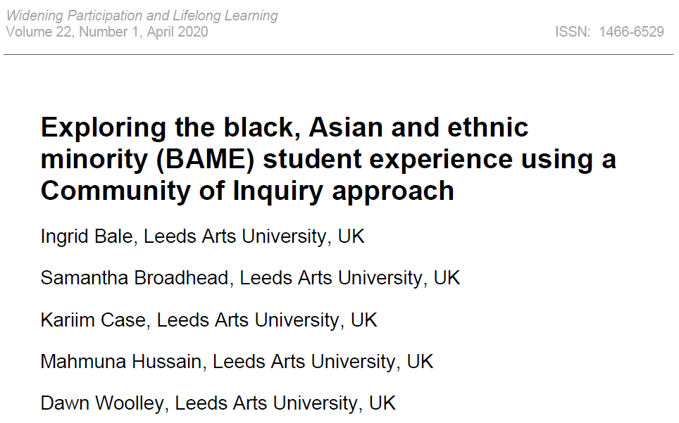
Research context
Original research in 2018-19
Funded by the institution
Investigating possible reasons for gaps between home students of white and minoritised ethnicity:
Participation
Retention
Awarding
NSS satisfaction
Why was this happening and what could be done to improve the situation?

Slide 4
Research context continued
Community of Inquiry as appropriate method
Led to actionable recommendations:
Buddy system for students of minoritised ethnicity if they feel isolated socially and academically
Specialist training to be undertaken by all staff to support recognising and dealing with racist incidents; challenge racist assumptions; decolonise the curriculum; diversify the learning environment
Clear and transparent processes for reporting racist incidents, and feeding back on outcomes
Forum for regular discussion of these issues
Recommended reading of Why I’m No Longer Talking to White People About Race (Reni Eddo-Lodge)

Slide 5
Further recommendations
Further actionable recommendations:
More work on display by diverse artists and students around the University
Calendar highlighting cultural holidays
Teaching examples to reflect a wide range of diverse practitioners and practices
Teachers to refer to reading lists of accessible books and resources in the library for students of minoritised ethnicity
Course team leaders to be aware if they have recruited only one or two black or ethnic minority students and have strategies in place so they do not feel isolated
Ideally, recruiting more students from these groups
Notes:
[all students would benefit from engaging with this material].

Slide 6
Moving forward
Multitude of actions arising from recommendations
Learning and teaching
Resources available
Creative work
Access
Critical reflections from that research
BAME classification aggregates the experiences of different ethnicities (Davies and Garrett, 2012; Singh, 2011; Whittaker and Broadhead, 2022)
Greater number of participants could lead to more broader experience represented in insights
Developing Community of Inquiry over time rather than one-offs
Notes:
Decolonising the Curriculum and the Inclusive University conference: to disseminate and explore these experiences and pedagogy; linked to Annual Course evaluations Decolonising glossary and resource bank online Events for students to talk about culture and identity Calendar
Report and support feature
Library diversification, spotlighting and acquisition fund
Gallery – exhibitions by creatives of colour Commissions programme linked with APP for creatives of colour
Targeted widening participation programmes in line with APP

Slide 7
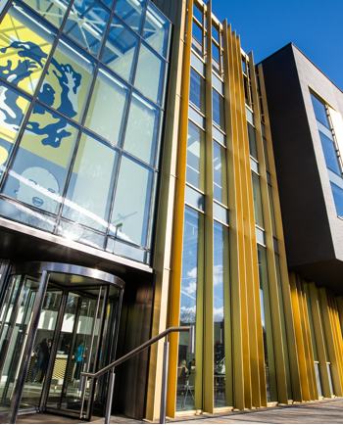
Aim for current research
Longitudinal Community of Inquiry (CoI) with students of minoritised ethnicity
Explore experiences of students of minoritised ethnicity
Evaluate the effectiveness of a longitudinal CoI approach as a method of researching students’ developing experiences
Identify awareness and perceived impact of measures to improve student participation and experience
Identify recommendations that could lead to improvements in the student experience

Slide 8
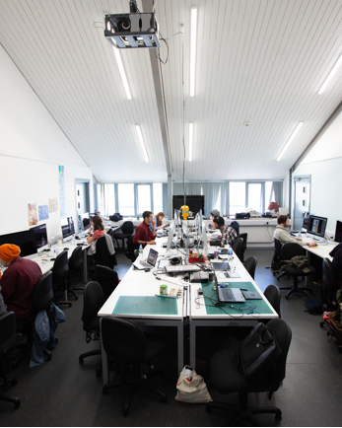
Recruiting participants
A list of students derived from administrative data
Students invited via email to take part
Aim for approximately 7-10 students / 10%
Offered of £35 for participation to acknowledge ongoing commitment of time and sharing their views and experience
Notes:
In 2018-19 and 2019-20, there were approximately seventy-five Level 4 students of Black, Asian and minority ethnicities, so the initial sample was approximately ten percent or seven to ten students split into two groups.

Slide 9
Longitudinal method
Cohort # | Year started degree | Details
1 | 2021-22 | 7-10 participating, split into 2 groups recruited during level 4 session mid-level 4 (2 hours, 3rd term 2022) session mid-level 5 (1.5 hours, 2nd term 2023) session mid-level 6 (1.5 hours, 2nd term 2024)
2 | 2022-23 | 7-10 participating, split into 2 groups recruited during level 4 session mid-level 4 (2 hours, 2nd term 2023) session mid-level 5 (1.5 hours, 2nd term 2024) session mid-level 6 (1.5 hours, 2nd term 2025)
3 | 2023-24 | 7-10 participating, split into 2 groups recruited at start of level 4 (autumn 2023) session mid-level 4 (2 hours, 2nd term 2024) session mid-level 5 (1.5 hours, 2nd term 2025) session mid-level 6 (1.5 hours, 2nd term 2026)
Whereas previous research (Bale et al. 2020) created a CoI as a single event that considered student experience at one point in time, this project seeks to consult the same community multiple times over a three-year period.
Table 1. Planned cohort details

Slide 10
Method
Two research facilitators recruited from postgraduate students of minoritised ethnicity
Trained in facilitation of CoI
External service transcribed the recorded discussion
Facilitators received further staff support in analysing the transcripts and discuss emerging findings and themes
Facilitators wrote up analysis into a final report including recommendations for appropriate measures to improve student experience

Slide 11
Method
Community of Inquiry process (Lassonde and Israel, 2009)
Stimulus
Absorption
Conversation
Formulation of Questions
Airing of Suggestions
Selection / Voting
First Words
Building Through Dialogue
Final Words
The written comments and post-it notes are then taken away to be analysed by the research team.

Slide 12
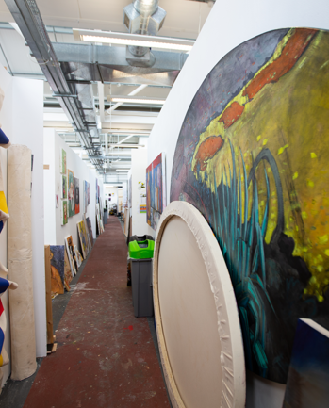
Ethical approach
Methodology
Payment for participation
Confidentiality and anonymity
Safer space
Sharing of issues/experiences
Research facilitators training, payment and support
Accountability
Support needs
Ceasing participation

Slide 13
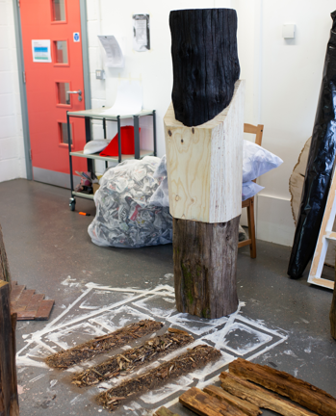
Findings
5 students took part in first year
Research facilitators found unexpected personal connection and investment with the research topic; reflexivity around impartiality
Initial findings revealed some findings that were different from the original iteration of the project:
Experience as prospective students and view of University marketing pre-enrolment
Relationships with other students of minoritised ethnicity and dynamics with their White peers
Forms of pedagogy associated with art and design
Discouragement and lack of understanding
Notes:
Attendees: (3 of whom have continued this year, so have invited more, 9 additional attended)
Based on their experience of the university so far as Level 4 students
Pre-enrolment: content influenced expectations and perceptions regarding uni and its student population – more diverse than reality, tokenism, leading to shock at unexpected lack of diversity of staff and students
Gravitating toward other students of minoritised ethnicity, alienation by White students; friendships harder to find, level of comfort on campus affected; microaggressions from staff and students; but didn’t report racism on campus
Pedagogy: sense of competition, students overlooked compared to others when presenting work related to non-western cultures.
Discouragement: limitation of creative practices – staff discouraging students from exploring some subjects outside of staff knowledge; favouritism identified in how staff value student work

Slide 14
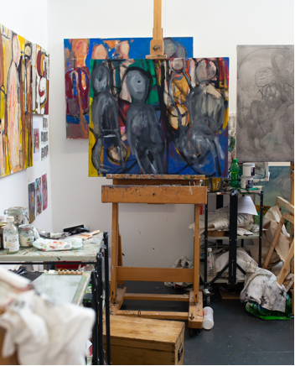
Reflections so far…
The importance of staff of minoritised ethnicity
Need to carefully monitor interventions as they may have unexpected consequences (assumptions and questions)
Challenges in doing this kind of work:
Barriers to creating safer spaces
Importance of supporting everyone involved as some of the stories are distressing
Notes:
Lot harder to create the safer spaces than you think on a practical level: how to bring people in, so that they’re not afraid of the conversations to the extent that they don’t happen

Slide 15
References
Bale, I., Broadhead, S., Case, K., Hussain, M., & Woolley, D. (2020 Exploring the black, Asian and ethnic minority (BAME) student experience using a Community of Inquiry approach. Widening Participation and Lifelong Learning, 22(1), 112-131.
da Costa, L. (2022) The global context for widening participation in creative arts higher education. In Access and Widening Participation in Arts Higher Education: Practice and Research (pp. 23-48). Cham: Springer International Publishing.
Davies, C. and Garrett, M. (2012) ‘The BME Student Experience at a Small Northern University: An Examination of the Experiences of Minority Ethnic Students Undertaking Undergraduate Study within a Small Northern University’, Compass, The Journal of Learning and Teaching at the University of Greenwich, 5: 1-10.
Lassonde, C., Israel, S. (2009) Teacher Collaboration for Professional Learning:Facilitating Study, Research, and Inquiry Communities, California: JosseyBass.
Singh, G. (2011) A Synthesis of Research Evidence. Black and Minority Ethnic (BME) Students’ Participation in Higher Education: Improving Retention and Success, York: Higher Education Academy.
Whittaker, R., & Broadhead, S. (2022) Disaggregating the Black Student Experience. In Access and Widening Participation in Arts Higher Education: Practice and Research (pp. 51-72). Cham: Springer International Publishing.

Slide 16
Thank you
Prof Sam Broadhead
@Samheadart

