Slide 1
Intro Slide Title 1
APS Seminar ‘Words matter’.
Dismantling the discourse of degree awarding gaps.
Rehana Awan
12 October 2023
Notes:
thank you for coming to listen to my talk about how language is used in degree awarding gaps.

Slide 2
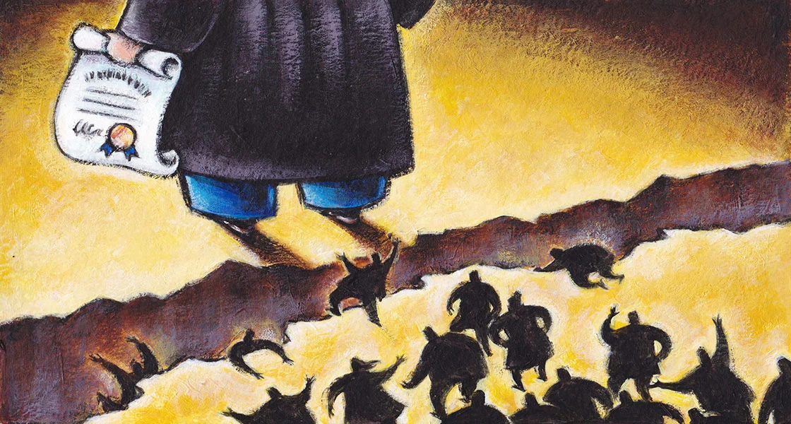
Slide Title 2
Words matter
Dismantling the discourse of degree awarding gaps.
A bit about me.
South Asian Heritage.
Lecturer at the OU.
Doctoral Researcher ‘ What’s the story? Exploring inequalities in outcomes through the narratives of Black and Brown students in a distance learning setting.’
Harvard Gazette, 2016, The costs of inequality: Education’s the one key that rules them all – Harvard Gazette
Notes:
I’m Rehana, from my bio you’ll know that I’m a Lecturer at the OU, have 2 girls and that I’m carrying out research for a doctorate in education. I’m in my 4th year and about to start writing up. The title of my study is on the slide. The focus therefore of this session is on dismantling the discourse of ethnicity awarding gaps. I’m sure you’re familiar with the term but just as a reminder awarding gap refers to the difference between the proportion of students from one group awarded a first or 2:1 in comparison to another group. Current sector data shows there is a 13.2pp gap between white students and students from Black, Asian and Minority Ethnic backgrounds. This means that 80.9% of students who are white are awarded a 2:1 and above but only 67.7% of Black, Asian and Minority Ethnic students.
You’ll notice I’ve chosen in the title of my study to use the words inequalities in outcomes rather than degree awarding gaps and this is quite deliberate, although this is only a working title so it may change after I’ve completed all my analysis. The reason for this is because there is power in the use of the word inequality because it makes the phenomenon of degree awarding gaps a sociological issue and embeds the problem into a broader, systemic and historical context. Some argue the education gap is the root of inequality.
‘..a strong education can act as the bejeweled key that opens gates through every other aspect of inequality, whether political, economic, racial, judicial, gender- or health-based.’

Slide 3
Slide Title 3
Words matter
Dismantling the discourse of degree awarding gaps.
Outline
Identity.
Race vs ethnicity.
Systemic and structural oppression.
Deficit model.

Slide 4
Slide Title 4
Words matter
Dismantling the discourse of degree awarding gaps.
Race vs ethnicity
Race based on physical and biological difference (Feagin, 2006) and constructed on stereotypes (Spencer, 2014).
Ethnicity - a grouping of peoples based on their cultural traditions, ancestry, and language.
Meanings have changed over time.
Race introduced in 1700s – a time of imperial expansion in Britain.
Whiteness as the norm (Gillborn, 2008).
Discourse of skin colour used to exclude people (Tomlinson, 2008)
Notes:
My research is centred on exploring the narratives of students who are Black and Brown. We often here about the ethnicity degree awarding gap, some people may even use the term racial awarding gap. But race and ethnicity are complex terms because they’re socially constructed with meanings which change over time. Race is a category of humankind that shares certain distinctive physical traits. Ethnicity on the other hand is said to be about large groups of people classed according to common racial, national, tribal, religious, linguistic or cultural origin or background. Race is about biology, skin colour and hair, and ethnicity is cultural expression and identification. Characteristics and behaviours are attributed rather than groups of people necessarily having those characteristics. I’m sure I don’t really need to point out to this audience that neither is detectable in the human genome despite earlier theories of race arguing race as a biological concept. However, referring to race as biological was exactly what happened during British Imperialism where whiteness became the norm (Gillborn, 2008). By doing this it allowed the creation of a subspecies and the application of a taxonomy or hierarchy which implied those at the top have more power and are seen as superior. Race relations are very much embedded in the history of imperial relations (Hesse, 2004, p135).
The 1700s was a period of imperial expansion in Britain, we’ve got the Kingdom of Great Britain being formed in 1707, there are wars with France and Spain, and Britain had colonies in the Caribbean, North America and India. By 1913 the British empire ruled over 400 million people and covered a quarter of the Earth’s surface but with power came great suffering for those colonies. Differential outcomes for those from the perceived minority were explained away as genetic differences when in fact these differences are attributable to systemic and institutional racism borne out of a post-colonial legacy.
Therefore, who is doing the ordering and decides on the categories is whoever has the power so how these words are used, matters.

Slide 5
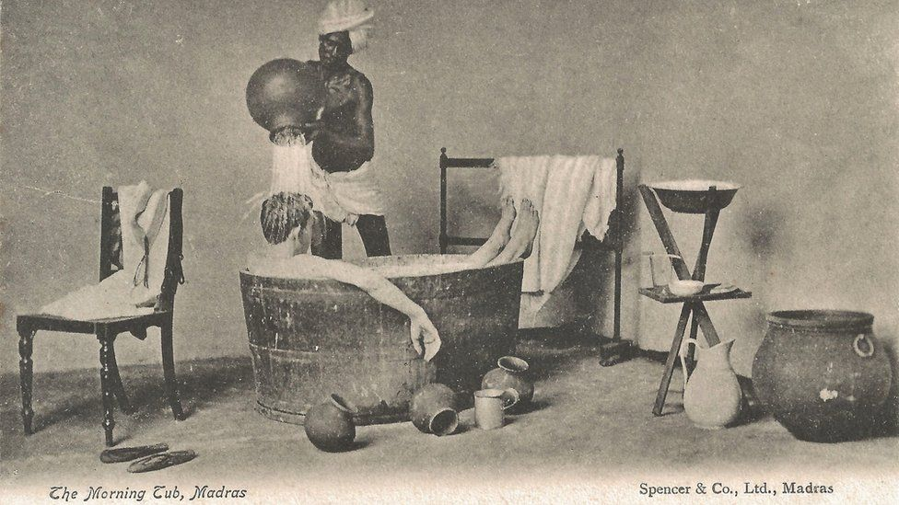
Slide Title 5
Words matter
Dismantling the discourse of degree awarding gaps.
STEPHEN PUTNAM HUGHES AND EMILY ROSE STEVENSON
Notes:
This postcard is taken from an exhibition at SOAS university which showed how postcards were used to communicate early images of Indians, racial stereotypes and urbanisation and daily life under British rule. The postcards also reflect how Indians were often stereotyped based on ethnicity, gender, religion or caste. Indians performing menial jobs for Europeans were also a common feature of these postcards. Many of these stereotypes exist today. I often here my elderly male relatives say ‘Sir’ when speaking to white males which one may misconstrue as polite but is in fact embedded in their colonial upbringing.
This postcard is titled The Morning Tub, and was published early in the 20th century and shows that Europeans often had help waiting on them while they bathed. "While Indians did all the work in postcards, Europeans living in Madras and Bangalore were rarely pictured unless they were being served or enjoying leisure time,"

Slide 6
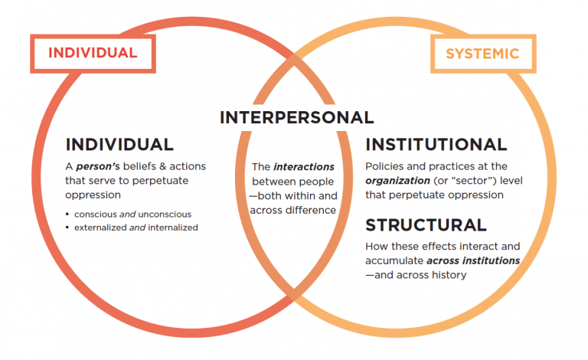
Words matter
Dismantling the discourse of degree awarding gaps.
Lens of Systemic Oppression — National Equity Project
Notes:
So, I’ve already said that differences are attributable to systemic and institutional racism borne out of a post-colonial legacy.
But what does systemic mean or look like?
This is when inequalities are so ingrained in society in its structures, systems and processes that there is structural and institutional oppression for certain groups in society.
Individuals may experience oppression in many ways, for example, labels, stereotypes and inequitable outcomes. Arguably, it is not possible to create equitable outcomes for students unless we dismantle the very structures that uphold them in the first place. However, in a neoliberal political climate where the Government through the Race and Ethnic Disparities Report in 2021 tries to bury inequality, this makes the challenge even harder.

Slide 7
Slide Title 6
Words matter
Dismantling the discourse of degree awarding gaps.
‘ What’s the story? Exploring inequalities in outcomes through the narratives of Black and Brown students in a distance learning setting
BME or BAME – reductionist (Stevenson, et al, 2019).
Ethnic minority or Minority Ethnic – marginal and less important (Unison, 2021).
Non-white – suggests white is the global majority which is untrue.
Black – politically can mean group together people who experience disparities in society, racism and have a shared history of colonialism and enslavement (Open University, 2020). Outdated – (Eddo-Lodge, 2020).
What about…white European experiences of racism living in the UK?
POC – Eddo-Lodge’s preferred term but connotations of ‘coloureds’ dating back to the 1950s and the Windrush generation.
Notes:
Even today we’re asked to fill in forms which seek to categorise us by age, gender, ethnicity etc. often these classifications are used to make assumptions about people with shared identities. But as we’ve heard these labels perpetuate historically embedded stereotypes, unconscious biases and prejudices.
Going back to my doctoral research then, I’ve used the words Black and Brown students rather than an acronym, or Black and Asian. My collaborators or participants are Black African, Black Caribbean, Pakistani, Indian and Bangladeshi (and that awful term Black or Asian other) either born here or abroad. Using Black and Brown was deliberate, although I have been told that when a white person has used these words they’ve been criticized and asked what other colours of the rainbow they might use to define someone’s ethnic background. I’ve chosen these terms because we use, Black and white and in in recognition of the differences between how people might chose to self identify versus how they might be categorized into homogeneous groups. I’ve already spoken about how social classifications systems are used to group difference for social order and oppression. But what about terms like BAME, BME, POC?
They are a great example of how language is ever evolving.
In the UK, the broad terms of Black and Minority Ethnic (BME) and Black, Asian, and Minority Ethnic (BAME) (used by the sector currently) are used to classify a range of ethnic minority groups living in the UK. These terms have become politicised because they are said to be reductionist (Stevenson, et al, 2019); the grouping together of a diverse range of people homogenises these groups. Minority Ethnic or Ethnic Minority suggests these groups are ‘marginal or less important’ (Unison, 2021). Essentially, the only difference is they are non-White, but the term non-White suggests that White is the ethnic majority world-wide, when globally this is untrue. Black can mean different things, Black African or Black Caribbean; Black is also used in a broader political sense to group together people who experience disparities in society, racism and have a shared history of colonialism and enslavement (Open University, 2020e). Some suggest acknowledgement that some White European groups living in the UK experience racism. However, others would argue these types of claims are used to detract from the deep-rooted systemic racism that has been experienced by Black people for centuries in order to dilute the issues they continue to face today (Akala, 2019). Political blackness or ‘trade-union black’ is said by some to be outdated (Eddo-Lodge, 2020) which can make one feel uncomfortable if using it. Eddo-Lodge’s (2020) alterative is People of Colour or POC, which is not yet widely used in the UK and for some has uncomfortable connotations of ‘coloureds’ dating back to the 1950s and the Windrush generation. POC is becoming increasing popular, particularly in ‘woke’ environments, despite this it is not yet a preference of the author. Asian is also a catch-all term which encompasses the Far East, South East Asian, and the Indian sub-continent and homogenises these groups. It is, therefore, difficult to find an appropriate term to describe diverse groups of people and to assume they have the same experience.
By homogenising we’re not able to distinguish the very different experiences of racially minoritized people which is especially important when it comes to inequitable outcomes because the experiences of Black Caribbean students is worse than that of someone with Indian or Chinese heritage.

Slide 8
Slide Title 7
Words matter
Dismantling the discourse of degree awarding gaps.
Deficit model - Awarding gaps vs attainment gaps
Attainment gap – academic weakness, wrong course choice, lack of ability (Singh, 2011, Cotton et al, 2016, NUS, 2019).
Awarding gap – responsibility on the awarding bodies (Jankowski, 2020, Stevenson, 2012).
Notes:
Finally, the literature suggests ‘attainment gap’ favours a deficit model; a model which looks to blame the individual for academic weakness, students making the wrong course choices or having a lack of ability (Cotton et al, 2016; Webber 2014; Stevenson, et al 2019; Mountford-Zimbars et al, 2017, Singh, 2009, NUS 2019). Awarding gap removes the onus from the individual and places responsibility with the awarding bodies (Jankowski, 2020, Stevenson, 2012a).
Language is powerful as it sends messages about what we think, what our position is and our world view. Words can be used to change the way people think when you consider affirmations and neurolinguistic programming and therefore, we need to choose our language carefully, especially when talking about inequitable outcomes, to ensure change is pushed for at a systemic level rather than individual. To a certain extent categories are needed for data and analysis but we need to avoid stereotypes and make sure we give agency to the differences. Got a long way to go to breaking down language barriers caused by pos the colonial barriers that still exist and impact on

Slide 9
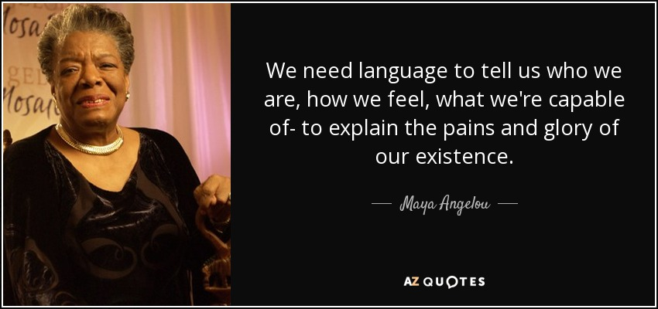
Slide Title 8
Words matter
Dismantling the discourse of degree awarding gaps.

Slide 10
Slide Title 9
Words matter
Dismantling the discourse of degree awarding gaps.
References
Eddo-Lodge, R., 2020 4. Political Blackness — About Race with Reni Eddo-Lodge (aboutracepodcast.com) [last accessed 13/4/2021]
Feagin, Joe, 2006. Systemic Racism, London: Taylor & Francis Group.
Gillborn, D. 2009. Chapter 3 Education as an Act of White Supremacy, Whiteness, Critical Race Theory and Education Reform pp43-59 Taylor, E., Gillborn, D., & Ladson-Billings, G. (Eds.). 2009. Foundations of Critical Race Theory in Education. New York, NY: Routledge.
Jankowski, G. S. 2020. The ‘race’ awarding gap: What can be done? Psychology of women section review. 1466-3724. British Psychological Society

Slide 11
Slide Title 10
Words matter
Dismantling the discourse of degree awarding gaps.
References
Open University. (2020) BME steering group statement
Singh, G., 2011. A synthesis of research evidence. Black and minority ethnic (BME) students’ participation in higher education: improving retention and success, Coventry University bme_synthesis_final_1568036653.pdf
Stevenson, J., O'Mahony, J., Khan, O., Ghaffar, F. and Stiell, B. 2019. Understanding and overcoming the challenges of targeting students from under-represented and disadvantaged ethnic backgrounds. Office for Students. Available at: https://www.officeforstudents.org.uk/media/d21cb263-526d-401c-bc74-299c748e9ecd/ethnicity-targeting-research-report.pdf [last accessed 20/3/2021]
Tomlinson, S., 2008. Race and education : policy and politics in Britain, Maidenhead: McGraw Hill/Open University Press
Unison, 2021. Defining Black Defining Black | Black members equality | UNISON National [last accessed 13/4/2021]

Slide 12
Slide Title 11
Thank you

Slide 13
Slide Title 12

