Slide 1
Intro Slide Title 2
That’s Not What That Word Means…
Fatmata Daramy
Co-lead of the Student and Staff Race and Ethnic Equity working group (SsREE), and a part-time research assistant, NERUPI (Network for Evaluating and Researching University Participation Interventions)
Dr Constantino Dumangane, Jr
Senior lecturer in Education, University of York

Slide 2
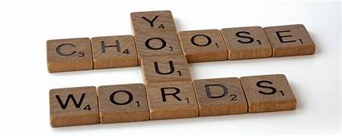
That’s Not What That Word Means... APS Words Matter Seminar
Presenters:
Fatmata K Daramy
Dr Constantino Dumangane
Notes:
FD edit using the accessiblity outline.

Slide 3
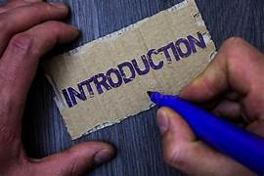
Contents
Padlet
Misunderstanding & Misappropriation of Words
History of Woke
The Complicated and the Problematic: When words become mainstream
Woke in the British Context
Glossary
Notes:
FD edit using the accessiblity outline.

Slide 4
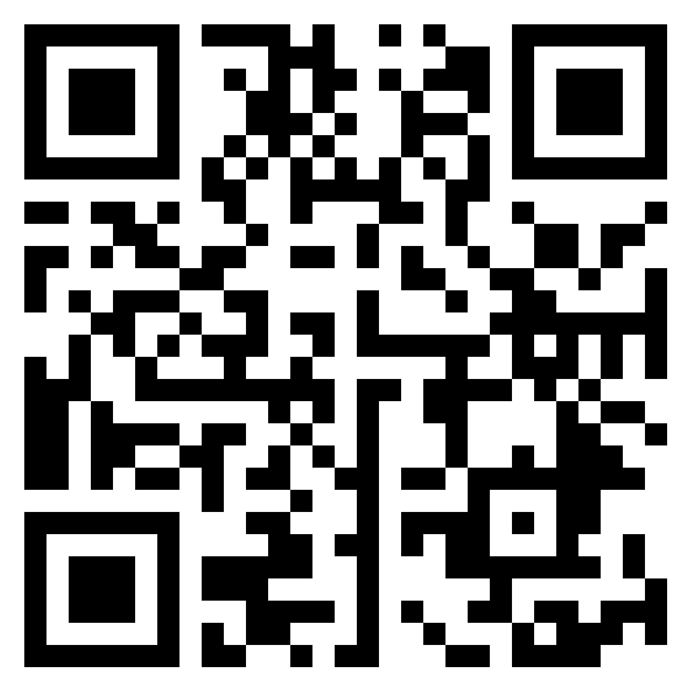
What Is The Definition of Woke?
Use the padlet link in the chat, or QR code below to define the word 'Woke'
Notes:
Link: https://padlet.com/fkd5/what-is-the-meaning-of-the-word-woke-1vg6st4o25b6qouy

Slide 5
Misappropriation and Cultural Appropriation
Misappropriation
Cultural (mis)Appropriation
When a group of people hijack a particular word or resource that has a historical context in a culture and declare their own misrepresentative definition of the word that catches on and then becomes normalised in society (Dumangane 2023, my definition)
When someone from a dominant culture adopts, exploits or uses intellectual property, (i.e., language traditional knowledge, cultural expressions, or artefacts from a minority culture)
Notes:
FD edit using the accessiblity outline.

Slide 6
History of Woke: A Timeline
Robinson, I. (N.D.). The Power of Language: How Woke went from “Black” to “Bad”. Legal Defense Fund.
Notes:
See slide notes – separate word doc

Slide 7
How many Britons know what the term “Woke” means?
Notes:
In this February 2021 YouGov poll, the pollsters only asked participants if they already consider themselves to know what the term means or not (and many didn’t), but the pollsters did not ask the participants to define the word woke
Source: https://d3nkl3psvxxpe9.cloudfront.net/documents/YouGov_-_What_is_woke.pdf

Slide 8
The Complicated and the Problematic: When words become mainstream.

Slide 9
In Britain, what beliefs are Woke?
Supporting the removal of historical statues with links to historical abuses like the slave trade, according to 60% of those who say they know what the term means.
Similarly, supporting the Black Lives Matter movement is considered woke by 56% of this group.
Supporting equality for transgender people is woke according to 52% of those who say they understand the term
Supporting equality for gay and lesbian people, 43%
Supporting gender equality, 40%
Supporting racial equality, 39%
Notes:
Within the UK two You Gov polls provide evidence of the lack of knowledge of – and/or the misappropriation and divergence from the intend meaning of the word woke.
When it comes to what constitutes wokeness, the view most commonly associated with the term were the following (read the percentages on the slide).
How problematic is that, the issues of supporting racial equality fell at the bottom of the list at 39%! This is the reality of what can happen when words become mainstreamed without full historical knowledge of their meaning and purpose.
IMPORTANT : Supporting a movement which one might be external to the community it concerns (Black people), is clearly not the same thing as the original meaning and purpose of the word woke

Slide 10
Glossary
01
02
Language and Power
Weaponisation
03
Intellectual Property

Slide 11
Process of Glossary Creation
PhD Research
Numerous Drafts
Yearly Review
Anger...
Expert Aid
General Research
More Research
Dissemination

Slide 12
Intersectionality
A concept that recognizes the complex and overlapping nature of social identities and oppressions. It describes how different forms of discrimination, such as racism, sexism, homophobia, and ableism, intersect and compound to create unique experiences of oppression for individuals who belong to multiple marginalised groups. Intersectionality highlights the need to address the specific needs and challenges of people with multiple identities and to create inclusive policies and practices that recognise and respect their diversity.

Slide 13
Critical Race Theory
Can be seen as part of critical sociology which starts from the perspective that society is inequitable, and it is the role of the discipline to reveal and oppose this. Critical Race Theory originated in the USA through legal studies and was specific to that field through the works of Prof. Derrick Bell and Prof. Kimberlé Crenshaw. In 1995, in the US, CRT transitioned from the field of law and civil rights into the field of Education via the work of Ladson-Billings and Tate, ‘Towards a Critical Race Theory of Education’ (1995). Almost a decade later, CRT in Education arrived in the UK (2003) - through the introductions of Gillborn’s work on ‘Education policy as an act of White supremacy’. Throughout the remainder of the early 2000s the expansion of CRT in Britain was promoted through the works of key researchers, Hylton, Preston, Chakrabarty, Warmington, Roberts and Mazzei.
There are basic tenets of Critical race theory:
Race is a social construct and not biologically determined.
Racism is a normal part of everyday life, and it is an ordinary experience for the majority of people of colour.
Interest convergence means that things such as legal advances or changes that apply to people of colour serve the interests of the dominant culture and dominant white groups.
Racism is endemic and is perpetuated through various formats.
In sum, critical race theory recognises that racism is not just the result of individual biases or prejudices but is also built into the systems and institutions of society and is pervasive. Critical Race theory seeks to understand how race and racism intersect with other forms of social identity and power structures in society.

Slide 14
Equity
Refers to the idea of fairness and justice in society, where everyone has access to the resources and opportunities they need to thrive, regardless of their background or identity. It recognizes that people have different needs and challenges, and therefore require different levels of support to achieve equal outcomes. Equity involves the redistribution of resources and the removal of systemic barriers that prevent certain groups from accessing the same opportunities as others.

Slide 15
Decolonisation
Refers to the process of undoing the impacts of colonisation, which typically involves the transfer of power and authority from colonisers to the colonised. This process includes redefining cultural identity, reclaiming cultural heritage, and addressing the injustices and inequalities that resulted from colonization. It involves dismantling the social, political, economic, and cultural systems that were imposed by the colonisers and replacing them with systems that reflect the values and aspirations of the colonised people. There have been many efforts to do this in different fields, specifically within the education sector with the aim of decolonising the curriculum being at the fore.

Slide 16
References
Allen, N. D. (2023). The misappropriation of “woke”: discriminatory social media practices, contributory injustice and context collapse. Synthese, 202(3), 84.
Oluo, I. (2019). So you want to talk about race. Hachette UK.
Robinson, I. (N.D.). The Power of Language: How Woke went from “Black” to “Bad”. Legal Defense Fund
Scafidi, S. (2005). Who owns culture?: Appropriation and authenticity in American law. Rutgers University Press.
YouGov Poll What does woke mean to Britons? [YouGov poll 26-28 February 2021]
YouGov Poll What does woke mean to Britons? [Updated - YouGov poll July 2022]

Slide 17
Thank You
Questions

Slide 18
Slide Title 30
Thank you

