Slide 1
Intro Slide Title 1
APS Seminar: 'Words Matter'
21 November 2023
Who ‘Belongs’ Anyway?: Looking at APP students’ own words to explore the accuracy and purpose of the term ‘belonging’
Personal Learning Advice Service
Enya-Marie Clay Jo Blissett
Helen Williams
Lynne O'Neil
Notes:
EC

Slide 2
Today we will explore...
What can feedback from students identified within the OU APS plan who have received coaching and mentoring support tell us about the experience of 'belonging’ and ‘mattering’ at the Open University?
Notes:
EC

Slide 3
We invite you to take a few moments to consider...
In what spaces do you feel a sense of 'belonging'?
What makes you feel this way?
How does feeling like you 'belong' affect how you feel and act in that space?
Notes:
EC
The power of language – what does it mean to 'belong’?

Slide 4
Take a few moments to consider and share...
What words do you associate with the term 'belonging'?
Notes:
EC Summarise the

Slide 5
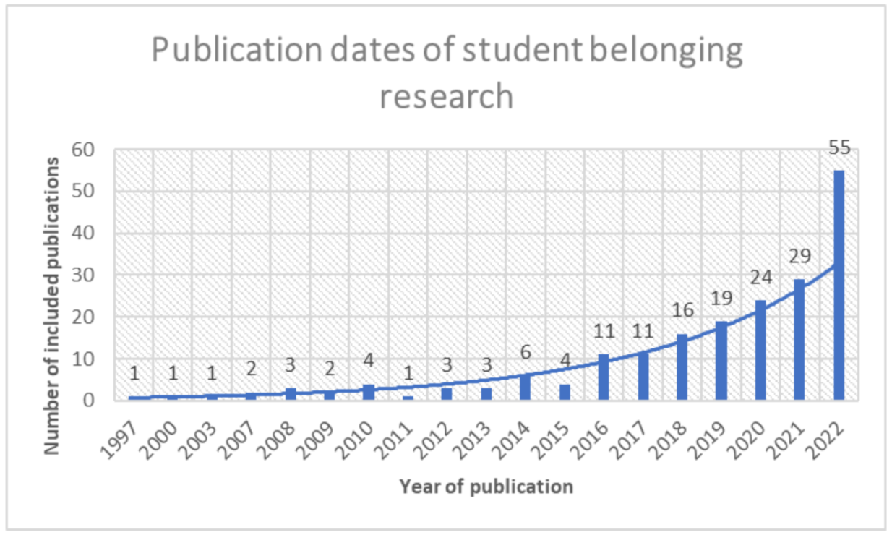
Slide Title 5
Student belonging articles included within a 2023 literature review, ordered by year of publication. Source: Gilani, D. (Oct 2023), ‘Building belonging a year on – how has higher education changed?’, WonkHE [online], Accessed 14/11/23.
Notes:
EC

Slide 6
Slide Title 6
About Student Belonging
“The term itself—sense of belonging—seems deceptively clear and explicit; but while many descriptions of it exist, there is a general lack of clarity and consistency among them.”
Peacock, S., et al. (2020). An Exploration Into the Importance of a Sense of Belonging for Online Learners. [emphasis added]
Notes:
EC Key point: there’s an assumed shared understanding of what we mean when we use this word as practitioners in an APS space in HE. However, what happens when we explore this further? What connotations does this term raise whether consciously or subconsciously? Refer back to the word cloud if relevant, or go straight to next slide

Slide 7
Slide Title 7
About Student Belonging
Screenshot taking from results when searching ‘belonging definition’ on Google (14.11.2023).
Notes:
EC With holding these questions in mind, we wanted to explore how this term came up for students in our work. To do this, we’re first going to give you a brief context of what we do in our roles as Personal Learning Advisers and what the Service is.

Slide 8
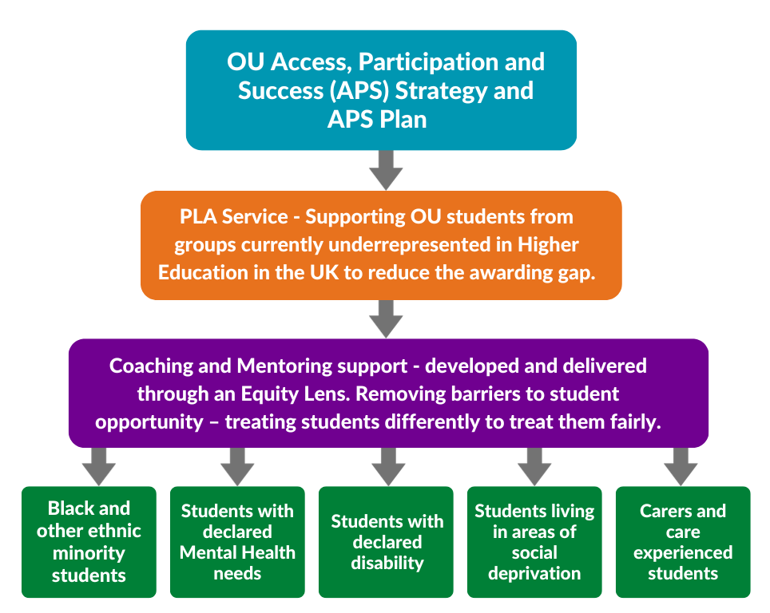
Slide Title 8
About the PLA Service
Access, Participation and Success at the OU
Using coaching and mentoring to help close the awarding gap between black and white students
Developing an equity lens: the experience of creating a professional framework for coaches and mentors
Notes:
EC Where the PLA Service fits in within the OU – our why, what and how

Slide 9
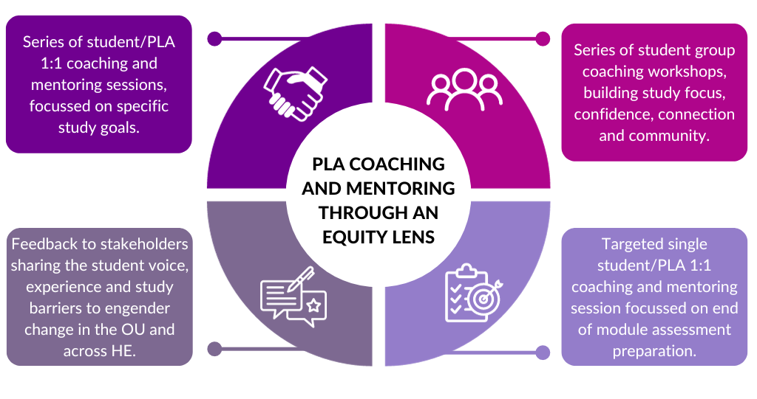
Slide Title 9
PLA Coaching and Mentoring Activity
Notes:
EC Within all our projects and student activities – capturing the std voice and feedback is key. We are now going to share some of this feedback around stds sense of belonging Note: Timing takes us up to 7.42 mins to the end of this slide

Slide 10
Slide Title 10
2022/23 Student Engagement and Feedback
Our recent PLA Service Review gathered data and feedback from 2022/23 students who had engaged with the Service, either in 1:1 sessions, groups workshops or both types of activities.
964 students participated in activities between Sept 2022 – June 2023
749 students were ‘available to survey’ (students not received an OU survey within the last 12 weeks)
81 responses from a participant list of 749 students = 10.8%
Notes:
JB
Survey question – I feel I belong at the Open University

Slide 11
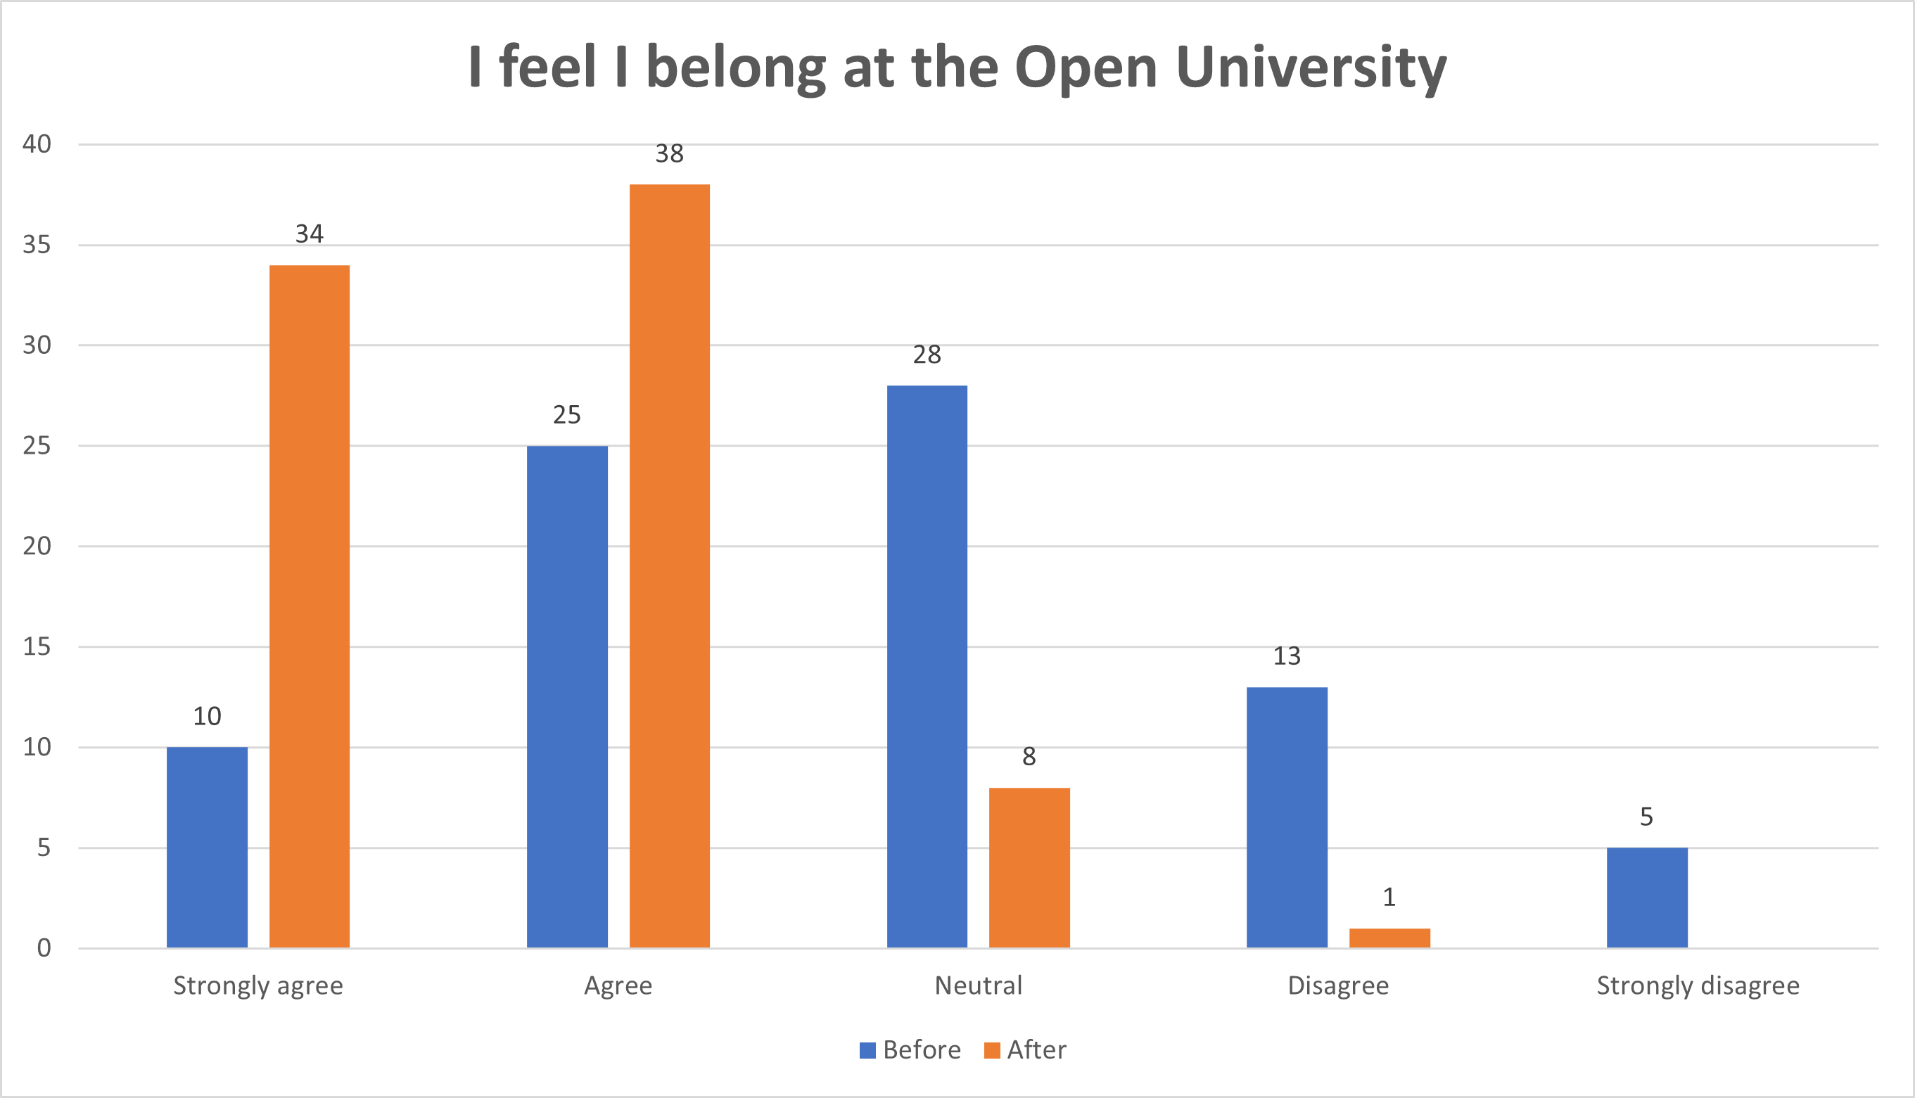
Slide Title 11
2022/23 Student Engagement and Feedback
How would you have answered this before the PLA session(s)?
How do you feel now?
I feel I belong at the Open University
 | Before | After
Strongly agree | 10 | 34
Agree | 25 | 38
Neutral | 28 | 8
Disagree | 13 | 1
Strongly disagree | 5
Notes:
JB
Survey question – I feel I belong at the Open University
What do stds feel they actually belong to? - the OU? , being a distance learner, a degree pathway, their module?

Slide 12
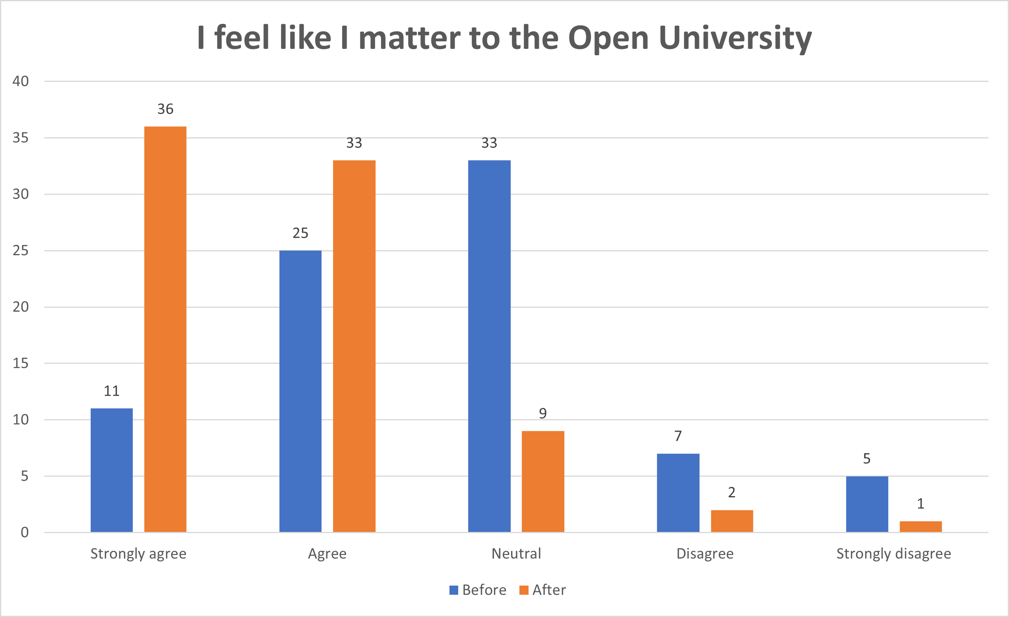
Slide Title 12
2022/23 Student Engagement and Feedback
How would you have answered this before the PLA session(s)?
How do you feel now?
I feel I matter at the Open University
 | Before | After
Strongly agree | 11 | 36
Agree | 25 | 33
Neutral | 33 | 9
Disagree | 7 | 2
Strongly disagree | 5 | 1
Notes:
JB
Survey question – I feel like I matter to the Open University

Slide 13
Slide Title 13
Student Feedback: Sense of Belonging
Students described PLA support as providing connection with their place of study as a distance learner. Many respondents described the anchoring effect of PLA support and almost 1/3 of all free text comments used the word “encourage/encouragement” directly.
‘’…we do most of our study alone so for me having someone to share my experience with is priceless.’’ Anon
‘’At the group workshops it was encouraging to note that there were others who had the same fears that you had. Others who sometimes felt they could give up but persevered. It was good to know that you are not alone.’’ Anon
"They always encourage me not to give up, to give it another go, they really are a blessing. The encouragement alone keeps me motivated but they challenge me to get as much as I can get out of being a student at the OU." Anon
Notes:
JB
NONE OF THE FREE TEXT COMMENTS MENTIONED BELONGING OR HAVING A SENSE OF BELONGING!

Slide 14
Slide Title 14
Student Feedback: They Feel Like They Matter
Students described PLA support as providing a space to be heard as a distance learner. Many respondents described the caring effect of PLA support . Our Service reviews highlight the importance of ‘mattering' and how this can impact student success.
"My PLA was extremely supportive, and I looked forward to every session with them. They made me feel like I am human and that they cared." Anon
“They helped me to see the skills that I have and helped me realise that being Neurodivergent is not a flaw, but actually, something, that brings out lots of positive strengths. The coaching sessions made me find purpose through challenging times, also made me realise that I am the one who can unlock all these great powers because I have the skills and I am determined." Anon
"My conversations with my PLA are varied with a lot of listening and suggestions. They also want to know how I'm feeling, ask what makes me feel better and work on ways to improve the situation." Anon
Notes:
JB

Slide 15
Slide Title 15
Student Feedback: Mattering enables aspirations
Students described PLA support as creating acceptance and self-efficacy as a distance learner. Many respondents described how this aspired them to move forward positively with their studies.
"I was able to formulate my own solutions and ways to overcome my barriers myself. I still don't think they realises how much of a difference they have made, not just as a student but as a person.“ Anon
"I think it actually, empowered me,
I needed someone to uplift me" Anon
‘’I felt listened too and understood all the time. I felt safe and welcome. Being able to say that things weren't all that great, at particular times, was a relief beyond words. Being heard is different to being listened to. Being allowed to speak and being respected for having a voice was such an incredible experience.’’ Anon
"It's that link you need to fire you up and be the best that you can be. Be open to what you are offered." Anon
Notes:
JB

Slide 16
We invite you to take a few moments to consider...
In what spaces do you feel a sense of 'mattering'?
What makes you feel this way?
How does feeling like you 'matter' affect how you feel and act in that space?

Slide 17
Slide Title 17
Beyond a Sense of Belonging
Our Service reviews and evaluation, student feedback and personal, in-depth conversations with students have provided us with valuable insights. We are developing our understanding of what makes a positive difference to students and their university experience.
But how do we capture the nuances of this?
Are the words belonging and mattering more of an institutional construct or measurement?
How relevant are the words belonging and mattering to students?
Can ‘belonging’ or ‘mattering’ really be measured?
What can we do to show students that they matter and that we care?
Notes:
JB

Slide 18
Any Questions / Discussion?
Notes:
Possible questions
How do I like to be shown by others that I matter? How do others show me that I matter?
Are the words belonging and mattering more of an institutional construct or measurement? Perhaps they are of limited relevance to ‘our’ stds?
Can ‘belonging’ or ‘mattering’ really be measured?
What can we do to show students that they matter and that we care?

Slide 19
Slide Title 19
References and Additional Resources
References: Gilani, D. (Oct 2023), ‘Building belonging a year on – how has higher education changed?’, WonkHE [online], Accessed 14/11/23.
Peacock, S., Cowan, J., Irvine, L., & Williams, J. (2020). An Exploration Into the Importance of a Sense of Belonging for Online Learners. The International Review of Research in Open and Distributed Learning, 21(2), 18–35. https://doi.org/10.19173/irrodl.v20i5.4539
Additional Resources:
Building Belonging in Higher Education: Recommendations for developing an integrated institutional approach (wonkhe.com) Building Belonging | Advance HE (advance-he.ac.uk)
What does it mean to become a student in higher education? | Wonkhe
Notes:
Gilani, D. (Oct 2023), ‘Building belonging a year on – how has higher education changed?’, WonkHE [online], Accessed 14/11/23.
Peacock, S., Cowan, J., Irvine, L., & Williams, J. (2020). An Exploration Into the Importance of a Sense of Belonging for Online Learners. The International Review of Research in Open and Distributed Learning, 21(2), 18–35. https://doi.org/10.19173/irrodl.v20i5.4539
Building Belonging in Higher Education: Recommendations for developing an integrated institutional approach (wonkhe.com) Building Belonging | Advance HE (advance-he.ac.uk)
What does it mean to become a student in higher education? | Wonkhe

Slide 20
Slide Title 20
References and Additional Resources Cont.
For more information about our Coaching and Mentoring Framework process, see: Clay, E., Blissett, J., Lindley, J., O'Neil, L. and Williams, H (2023). ‘Developing an equity lens: the experience of creating a professional framework for coaches and mentors.’ Journal of Learning Development in Higher Education, 26: Special Issue Equality, Diversity and Inclusion. Available here
For more information about our coaching and mentoring work, see:
Lochtie, D. and Hillman, J. (2023). ‘Using coaching and mentoring to help close the awarding gap between Black and White students.’ Teaching Insights. Available: here.
Hillman, J. and Lochtie, D. (2023). ‘Coaching and mentoring as “targeted” Learning Development provision,’ Learning Development Magazine (April), pp. 20-21. Available here.
Samuels-Hylton, J. and Wilton, M. (2023). ‘Sharing stories of resilience: Open University partnership work with Shelayna Oskan-Clarke,’ Learning Development Magazine (July), pp. 12-13. Available here
Notes:
For more information about our Coaching and Mentoring Framework process, see: Clay, E., Blissett, J., Lindley, J., O'Neil, L. and Williams, H (2023). ‘Developing an equity lens: the experience of creating a professional framework for coaches and mentors.’ Journal of Learning Development in Higher Education, 26: Special Issue Equality, Diversity and Inclusion. Available here
For more information about our coaching and mentoring work, see:
Lochtie, D. and Hillman, J. (2023). ‘Using coaching and mentoring to help close the awarding gap between Black and White students.’ Teaching Insights. Available: here.
Hillman, J. and Lochtie, D. (2023). ‘Coaching and mentoring as “targeted” Learning Development provision,’ Learning Development Magazine (April), pp. 20-21. Available here.
Samuels-Hylton, J. and Wilton, M. (2023). ‘Sharing stories of resilience: Open University partnership work with Shelayna Oskan-Clarke,’ Learning Development Magazine (July), pp. 12-13. Available here

Slide 21
Thank you
You are welcome to contact us via email:
Enya-Marie Clay: enya-marie.clay@open.ac.uk
Jo Blissett: jo.blissett@open.ac.uk

