Slide 1
Bridging the Gap: The Limitations of Language
Dr Frankie Morgan (she/her)
Aspire to HE – University of Wolverhampton
f.morgan3@wlv.ac.uk
@fpmresearch
Notes:
My background - Non-selective state school, FE college before going onto do my undergrad and MA in Art History at UEA and then my PhD in Gender Studies at UoB. Whilst at school and college I benefitted greatly from widening access initiatives, inc a summer school at Cambridge University targeted towards students from FE colleges in deprived areas. Now I work in widening access as the progression officer for Aspire to HE – a UniConnect partnership based at WLV. This lived experience and positionality has shaped how I approach this issue of how and why words matter in the field of access, participation and success.
In this presentation I will explore how the language that we use in APS can be limited and flawed, thus there is a need for us to consider explicitly how we can use words in order to create connection and belonging and bridge the gap between the students with whom we work and Higher Education.

Slide 2
The Limitations of Language
Notes:
The terms we use to describe the students we work with in this field, such as underrepresented and disadvantaged, treats them as a homogenous monolith that does not account for the multiplicities of lived experiences and personal contexts within the cohorts of students with which we work. Such terms can create an othering than compounds a sense of lack of belonging, thereby cementing the feeling of disconnect between learners and HE. Whilst this might not be the language that we use with students, it is still the language which describes and defines the work we do and informs our praxis. This is not to say that we should stop using such language but rather that it’s important to recognise its limitations and the ways in which it can create a disconnect between our work and the lived reality of the students with which we work. Consequently, there is a need to move beyond simplification and homogenisation and understand students’ contexts and experiences and build connection.

Slide 3
PhD Tutor for a university-access charity
The charity mobilises the PhD community to support students to access the most competitive universities and succeed when they get there.
I worked with students in non-selective state schools in Stoke-on-Trent, Staffordshire and Telford and Wrekin (Years 8-10).
The seven-week programme consisted of research-driven content and university-style sessions to give students the knowledge, skills and confidence to progress to the most competitive universities.
The students targeted were less likely to progress onto these universities due to factors beyond their control (pupil premium, deprived postcodes and no parental history of HE).
Notes:
During my PhD I was a tutor for university-access charity which was instrumental in informing the ways in which I build connection with students by drawing on their lived experiences and pre-existing knowledge.

Slide 4
ASPIRE TO he
Aspire to HE is a UniConnect partnership based at the University of Wolverhampton.
We work with 42 schools and 6 colleges across the Black Country and Telford and Wrekin.
We work with thousands of students each year (Years 7-13) to help them make informed and ambitious decisions about their future and achieve their full potential through Higher Education.
The students we work with live in low HE participation postcodes.
The University of Wolverhampton is ranked in the top ten for social mobility and diversity and 1st for students with no parental history of HE.

Slide 5
Differences
University-Access Charity
Groups of 6-12 students.
Research-driven content and university-style sessions.
7-week programme in schools.
High attainers.
Aspire to HE
Groups of 30 students.
HE focussed interactive sessions.
Campus visits.
Mid attainers.
High levels of racial, ethnic and religious diversity.
Notes:
There are some key differences between two organisations in regard to the types of students they work with and sessions they deliver. Go through notes on screen. Despite these differences, it remains important to build connection by drawing on students lived experiences and pre-existing knowledge in order to bridge the gap between themselves and HE.

Slide 6
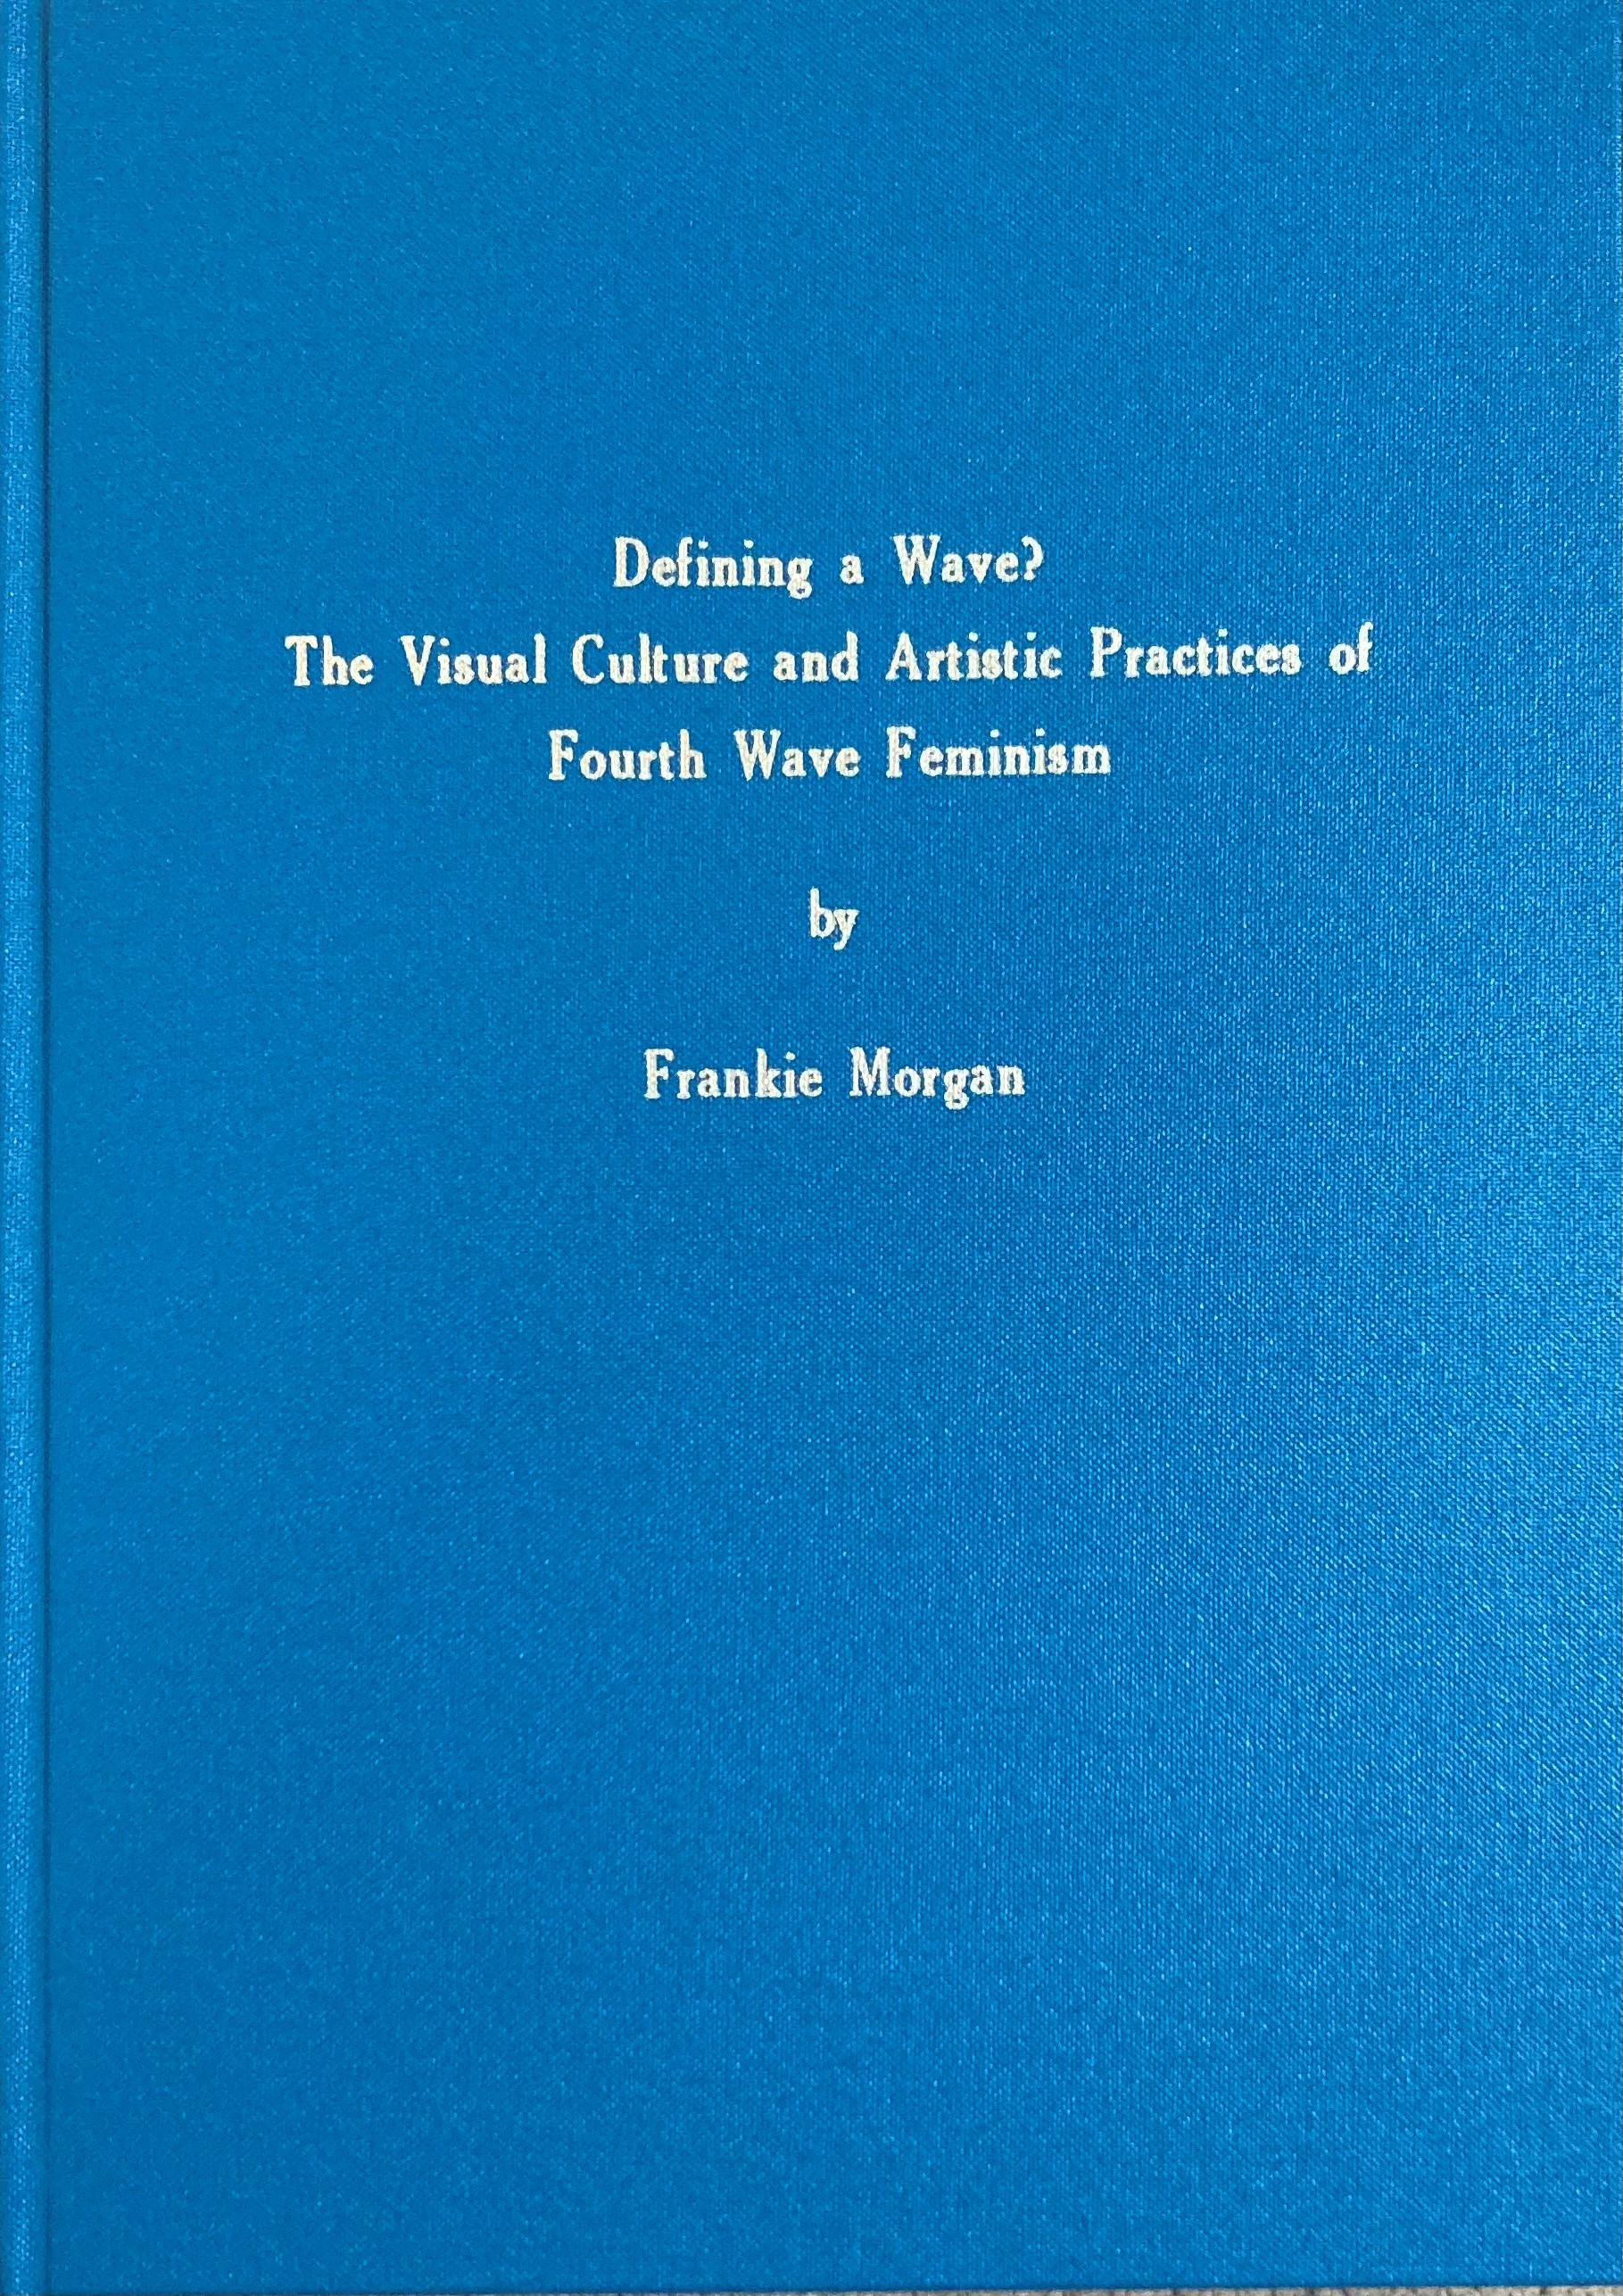
Bridging the Gap THROUGH UNIVERSITY-STYLE SESSIONS
Notes:
The 7-week course I delivered whilst I was a PhD tutor centred on my doctoral research, which was feminist art and visual culture and online activism. Therefore, I had to translate PhD-level research to secondary school students. Whilst this particular topic is something that the students were unfamiliar with and completely different to what they would do in school (art history and gender studies), they already had experiences and knowledge that could help me to connect them with the material (helped to build confidence and self-efficacy). For example, one session focussed on the role of art and images in online activism, with social media being a central part of this discussion and if there’s one thing that teenagers know a lot about and experience everyday, it is social media. Therefore, by establishing and activating their pre-existing knowledge through discussion, including knowledge established through their own lived experiences, I was able to bridge the gap between the students’ lived reality and academic research. (emphasise discussion being a core elements of this) Overall, it is important to recognise and treat students as experts of their own lives and experiences. But it can also be important to challenge misconceptions in their knowledge.

Slide 7
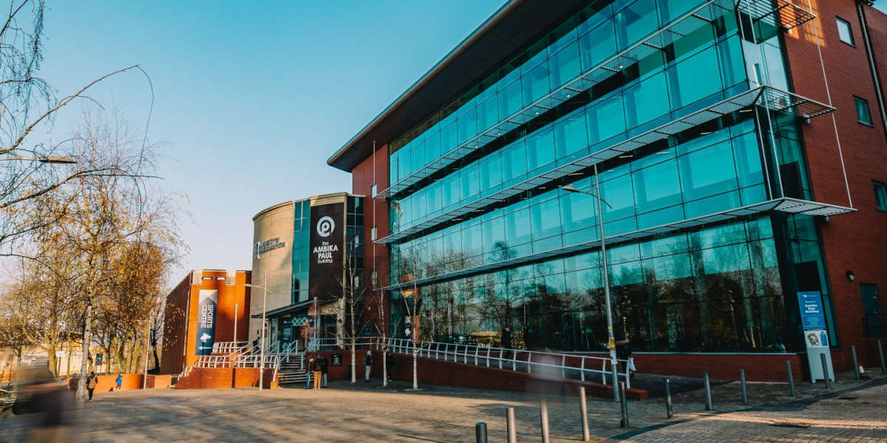
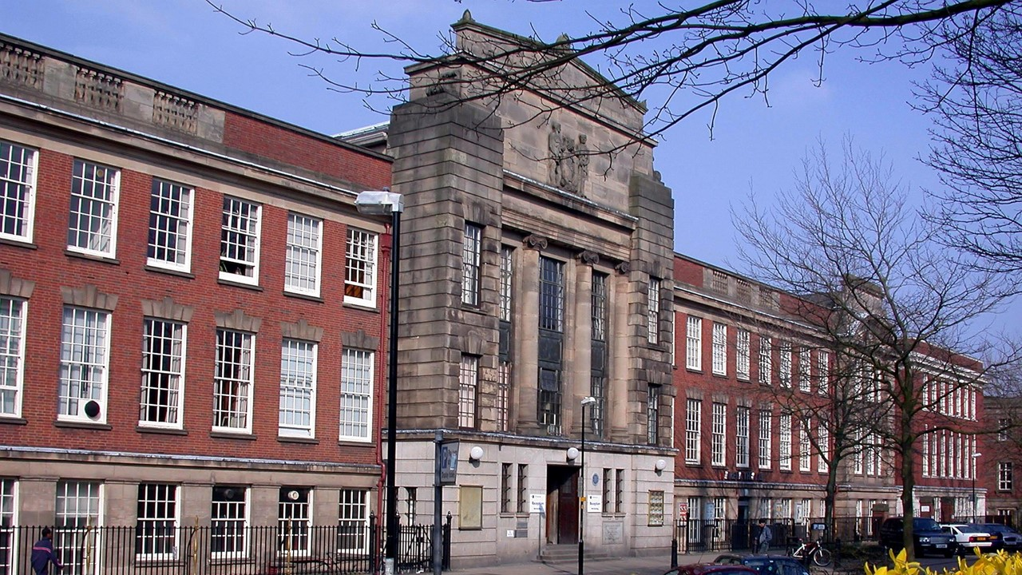
Bridging the Gap THROUGH CAMPUS VISITS
The University of Wolverhampton, City Campus
Notes:
For our campus experience days we bring students (this year just Y11) onto the University of Wolverhampton’s City Campus and allow them to experience university life and learn about HE and develop transferable skills through engaging and interactive activities. Every student that comes onto campus brings with them existing knowledge and preconceptions about HE, especially university. This knowledge is largely established through their own personal experiences, relations and contexts, such as school, friends and family. I seek to establish and activate this prior knowledge through icebreakers discussion, whether it’s on student finance or why people go to university. Not only does this allow me to understand what they already know, but also challenge any misconceptions that might be acting as a barrier, e.g. ideas surrounding student loans. Furthermore, as practitioners, by sharing our own experiences of HE and education more broadly, we can connect our own lived experiences with theirs, which can instil a sense of belonging and connection, bridging the gap between their own lived reality and HE. Indeed, it is important to tailor and adapt our responses and discussions based on the needs or knowledge of the group of students. To do this, it is essential to listen and engage with what the students are telling us and respond accordingly, keeping adaptability, responsiveness and reflectiveness as a central principles of our practice, regardless of whether you are teaching feminist art or student finance.

Slide 8
Going Forward
Notes:
The Future Thinking programme is a 6-week attainment-raising metacognition course aimed at Y8s, developed in conjunction with the Humber Outreach Programme, which we hope to deliver in 20 targeted schools. We have recently delivered the pilot of the programme in a school in Stourbridge. In the sessions we seek to establish and activate the students’ prior knowledge through discussion, as well as discuss how they can apply what they learn in the sessions in their other school subjects and beyond. This helps them to think about their own learning and thinking more explicitly. Connecting what they already know and do with metacognitive skills and strategies (without using language of metacognition as too complex and would alienate students) The final session takes place on the university campus to allow learners to experience university life, as well as consolidate and connect what they have learnt through out the programme with the university context.

Slide 9
Conclusion
The language we use can be limited and flawed.
It is important to bridge the gap between the students with whom we work and the material we teach and environments we teach in.
Building connection with students and their lived experiences and realities can help to establish a sense of belonging and self-efficacy.
As practitioners, we need to think clearly about the words we use and how we can use language to build connections, including by sharing our own lived experiences.

